Slide 1

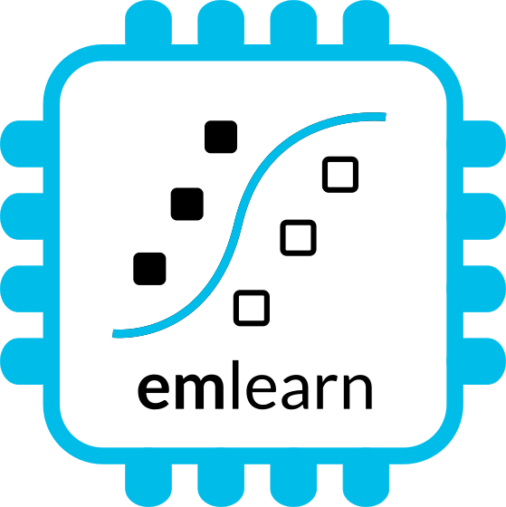
Microcontrollers and Machine Learning
with MicroPython and emlearn https://github.com/emlearn/emlearn-micropython
Jon Nordby jononor@gmail.com
foss-north 2025
Notes:
Hi everyone. Glad to see so many being curious about microcontrollers! I have with be a munch of MicroPython compatible devices today. So if anyone is interested in borrowing for trying it out, we can do that after the session. On the A floor, next to the tutorial rooms. And one lucky person that asks a question will get one of these devices to take home!

Slide 2
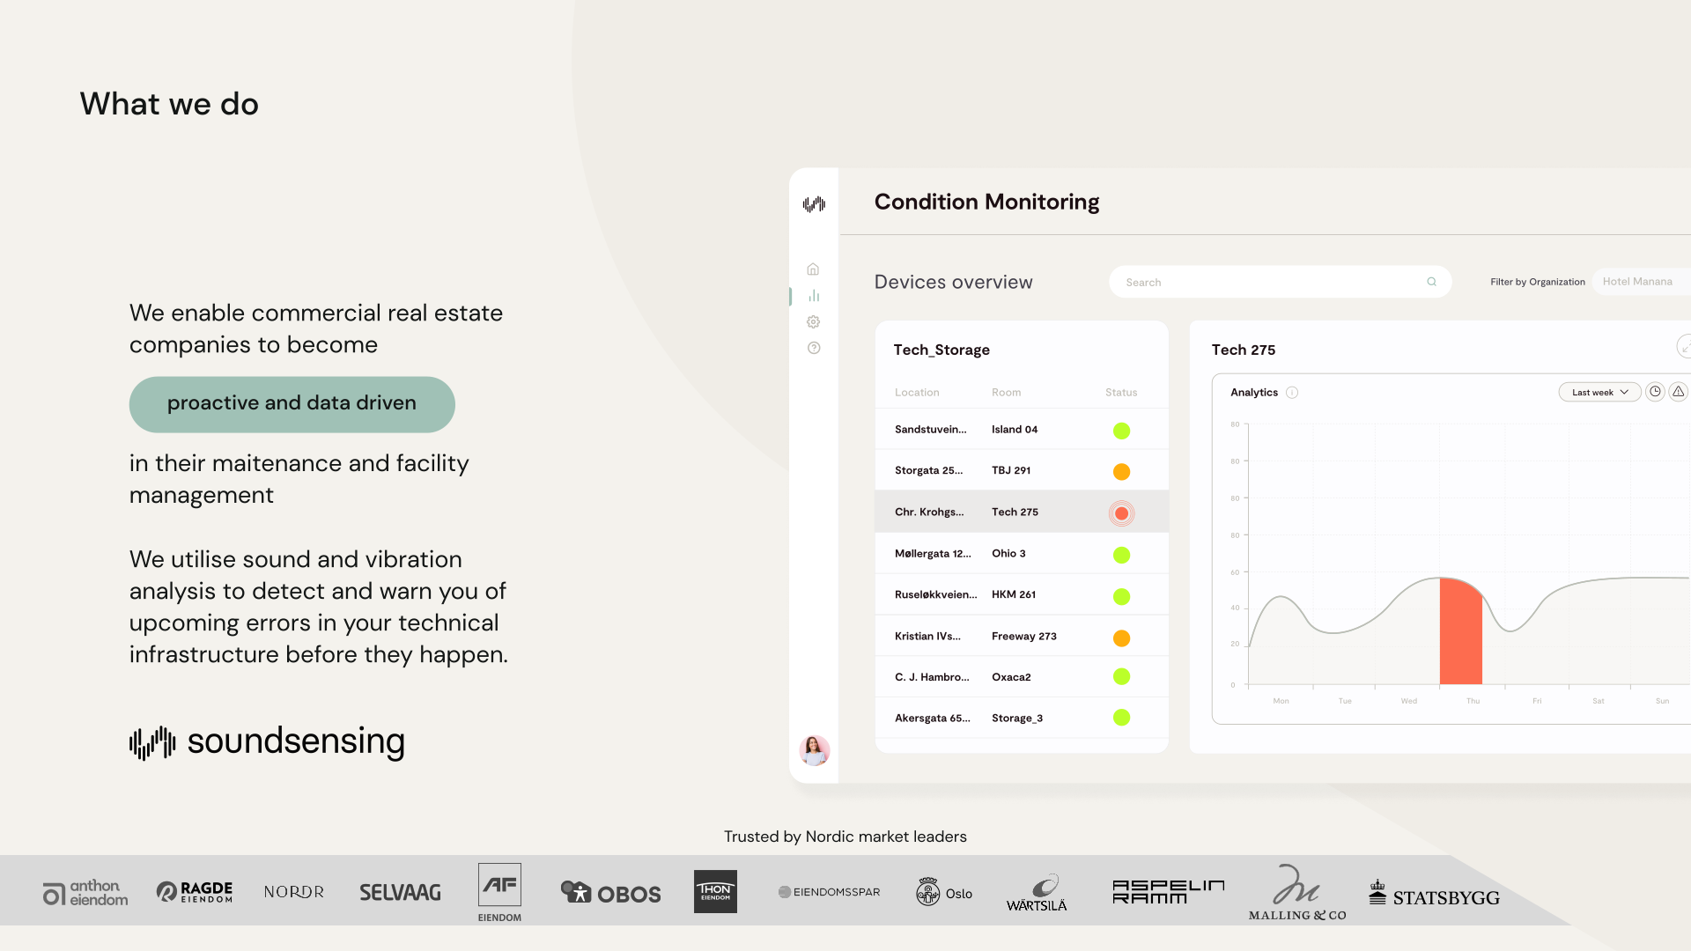
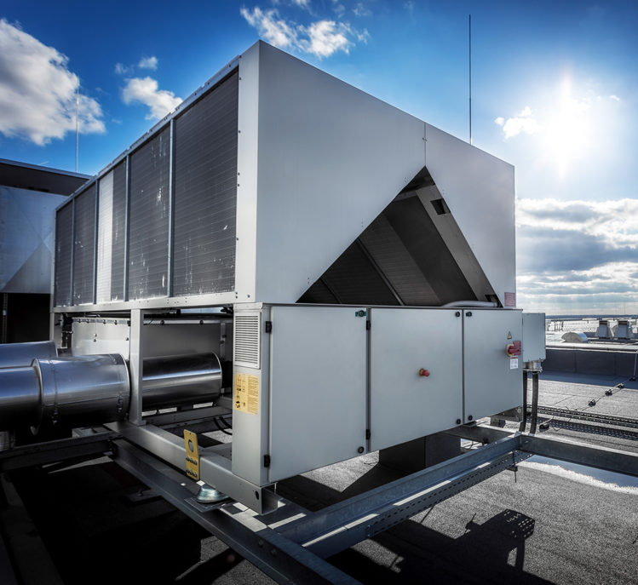
Notes:
Work as Head of Data Science at Soundsensing.
Soundsensing is a leading provider of predictive maintenance solutions for ventilation systems in buildings. So we work a lot with sensor data. And also use Python as much as we can for Data Science, IoT and backend tasks.

Slide 3
Goal
You, as a Python developer, can build an IoT sensor on a microcontroller using MicroPython
+ Including on-edge Machine Learning with emlearn-micropython
Purpose of this presentation
Notes:
The goal of the presentation today is …

Slide 4

Python on Microcontroller
Jumping right into it

Slide 5
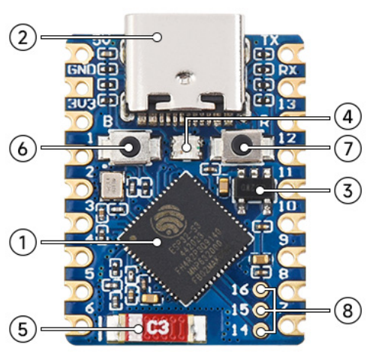
What is a microcontroller?
Modern microcontroller: A complete programmable System-on-Chip
Example: ESP32-S3FH4R2
32 bit CPU, 240 Mhz Floating Point Unit 2 MB RAM 4 MB FLASH
WiFi Bluetooth Low Energy
USB-C
Espressif ESP32-S3FH4R2 chip: 2.5 USD
Waveshare ESP32-S3-Tiny board: 6 USD

Slide 6
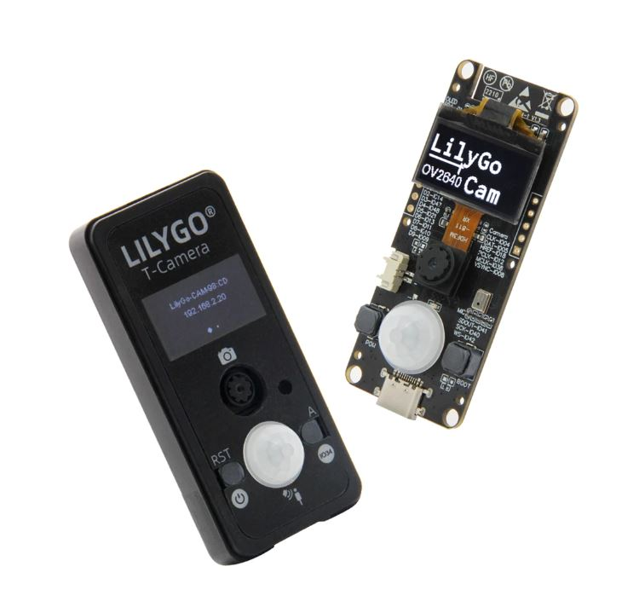
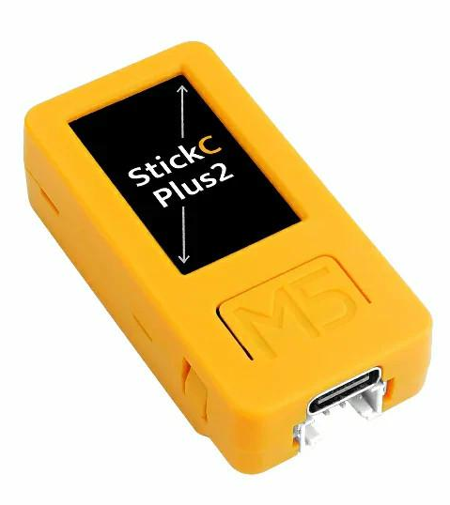
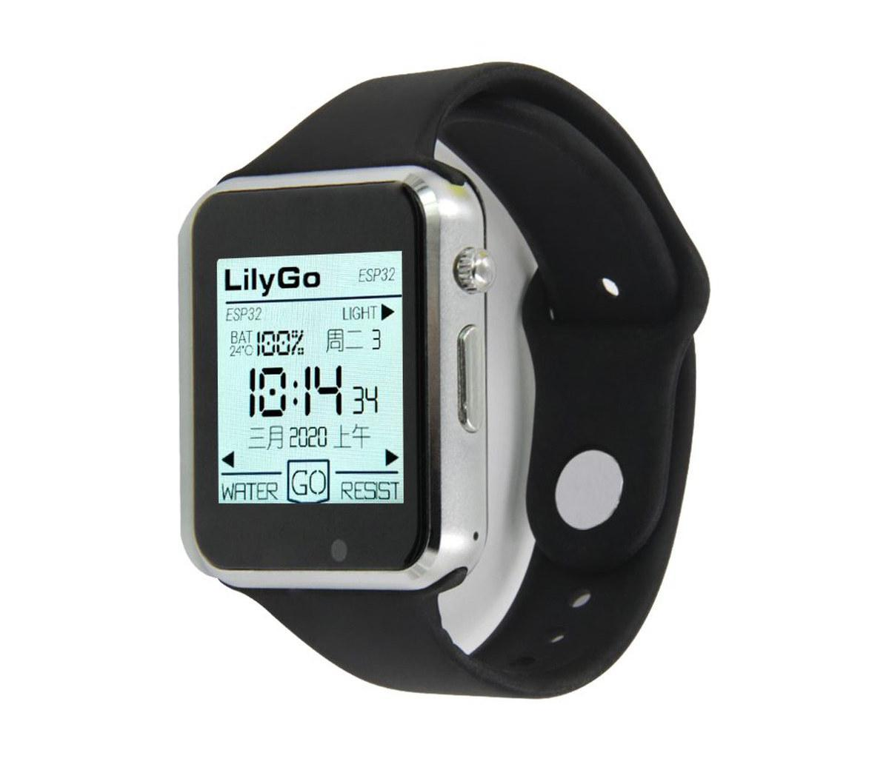
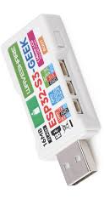
Hardware tinkering optional - complete devices available
Complete ESP32 based device with sensors etc.: 20 - 50 USD
Notes:
?

Slide 7
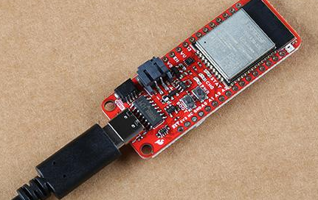
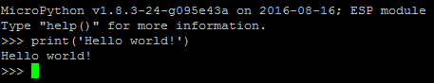
Installing MicroPython
Download prebuilt firmware https://micropython.org/download/?port=esp32
Flash firmware to device
pip install esptool
esptool.py --chip esp32 --port … erase_flash
esptool.py --chip esp32 --port … write_flash -z 0 micropython-v1.17.bin
Connect to device
pip install mpremote mpremote repl
IDE (optional): Viper IDE, Thonny, et.c.
Notes:
! drives for peripherals that are on a board not included in core firmware
Will likely need to hunt a bit for each sensor, screen etc

Slide 8
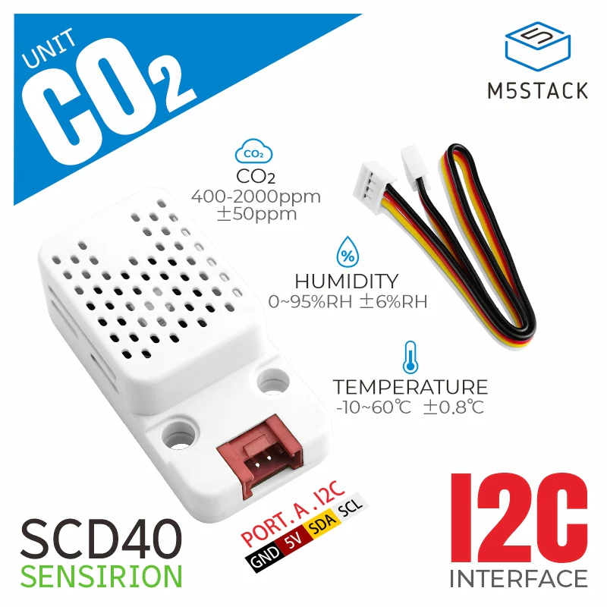
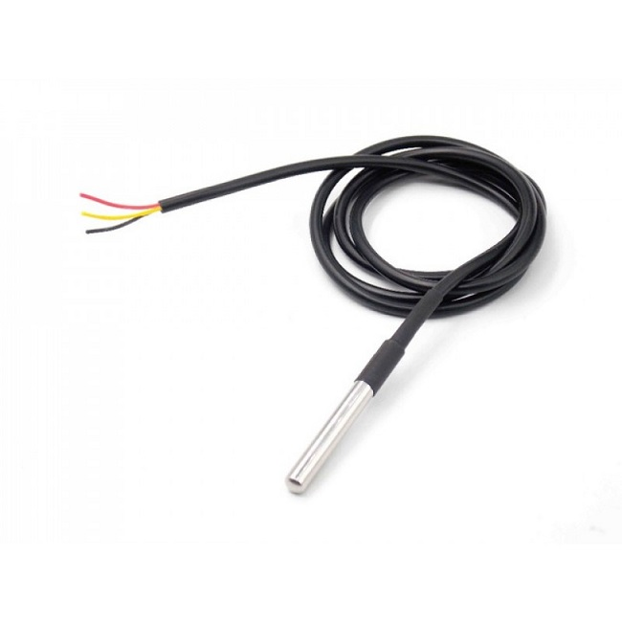
Temperature sensor - hardware
Example MPU6886 accelerometer built-in temperature sensor
Temperature Sensor
DS1820 Water-proof
Room Monitoring
+ CO2 + humidity + temperature
Notes:
?

Slide 9
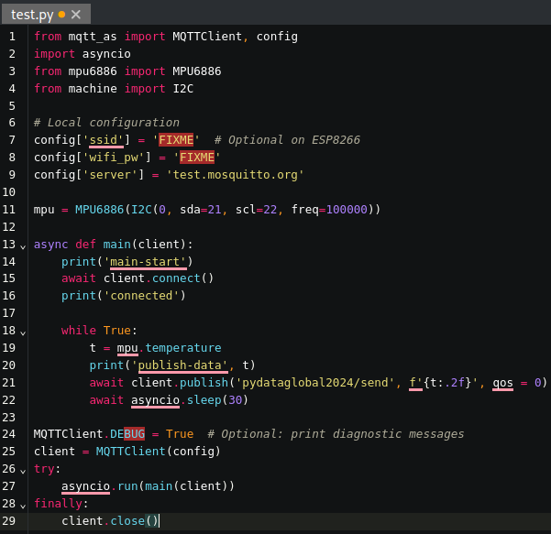
Temperature sensor - code
Using https://viper-ide.org/
Zero-install. Connect to device via USB
1. Read the sensor in a loop
2. Send data using MQTT
3. Wait until next measurement
The same approach can be used for sensing other slow changing phenomena
Using peterhinch/micropython-mqtt and jonnor/micropython-mpu6886
Notes:
Temperature is a slow changing phenomena. Want: 1 value for longish time interval (ex: 5 min)
! Sensor can be noisy. Filtering advised
Will show analog sensor example. Same approach can be used for a digital sensor. And for other slow-changing phenomena.

Slide 10
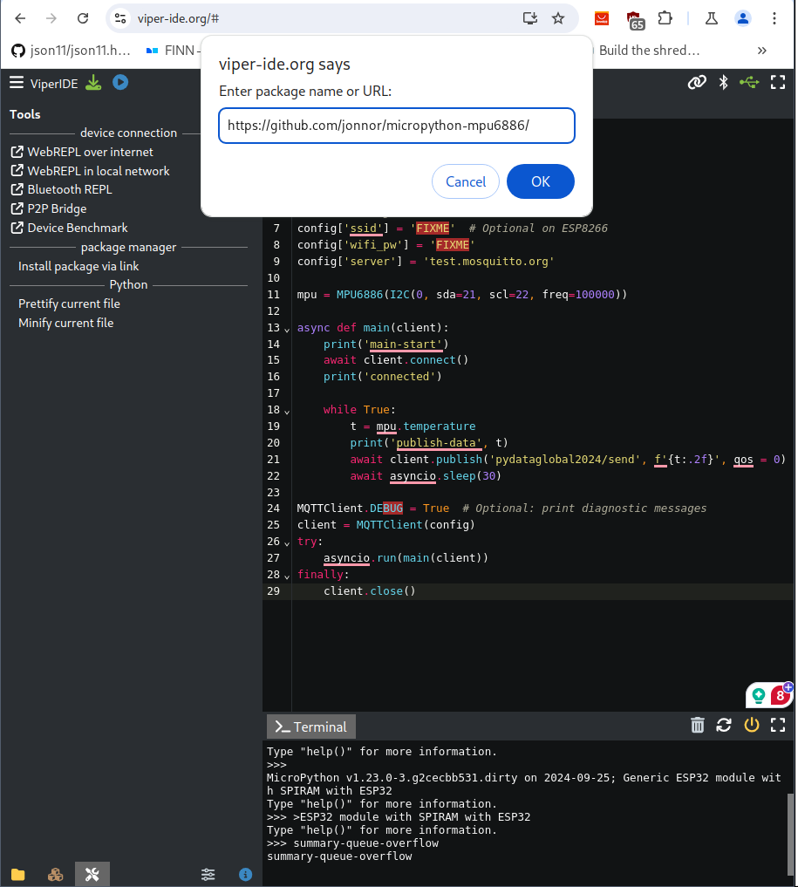
Installing packages
MicroPython has a package manager “mip” Directly on device!
ViperIDE supports install via UI Custom packages via URL
Notes:
Has support for loading C modules at runtime!

Slide 11
Sensor nodes with MicroPython
What can be done on an ESP32 microcontroller with MicroPython and how to make it work

Slide 12
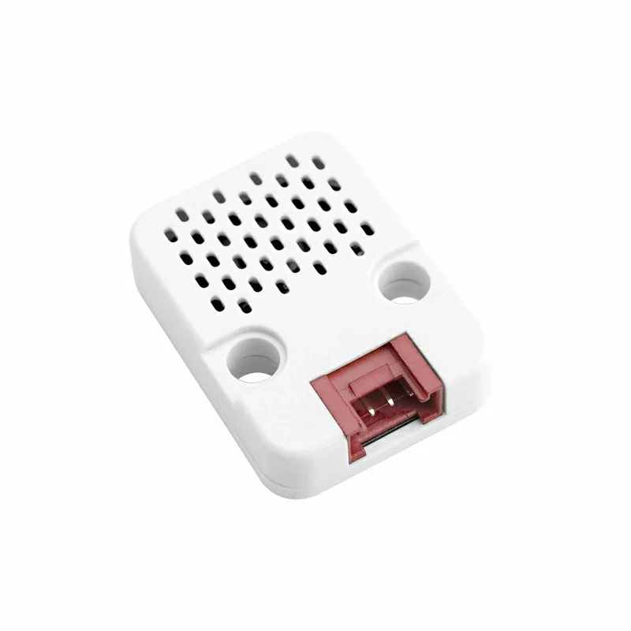
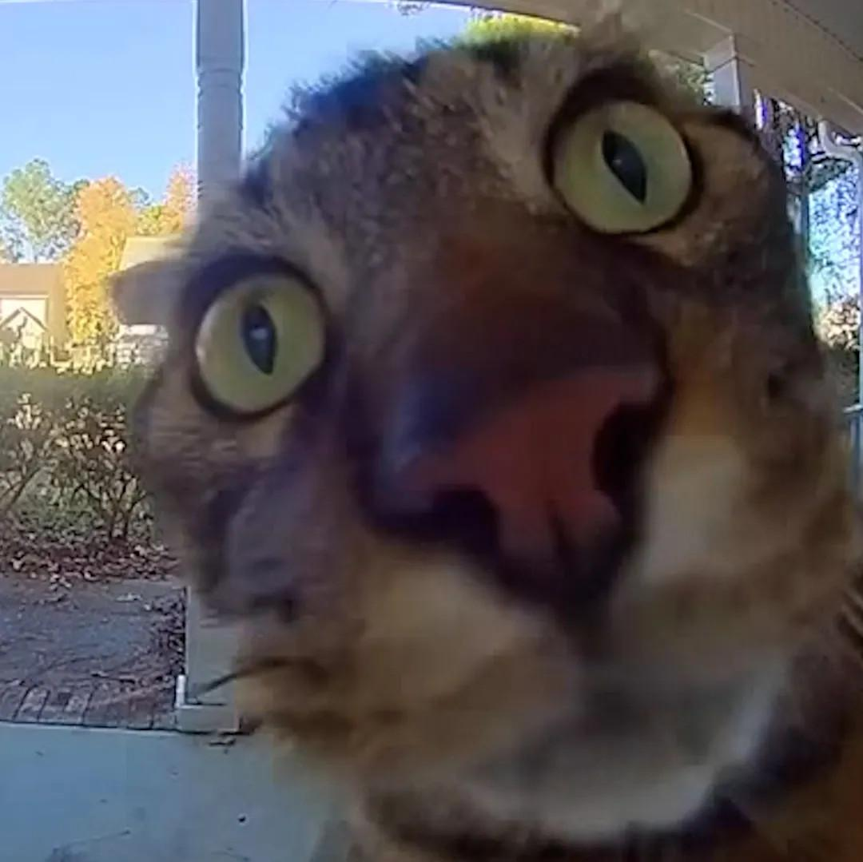
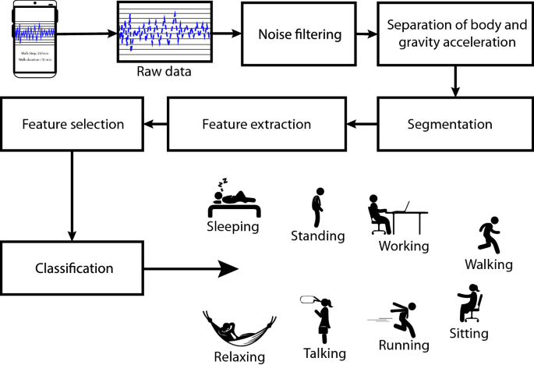
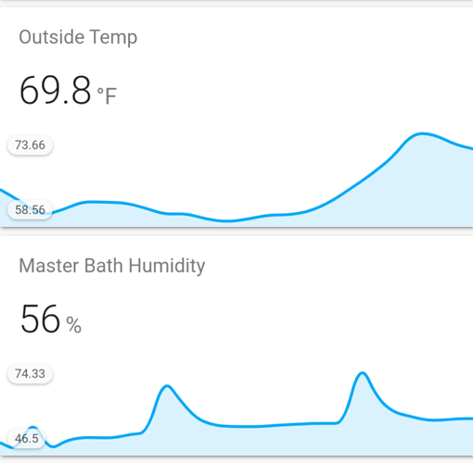
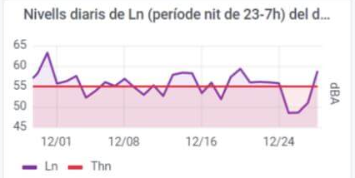
Temperature logger
Activity tracker
Noise monitor
Image
Classifier
Temperature 0.1 Hz
Accelerometer 100 Hz
Microphone 16000 Hz
Camera 27000 bytes/s
if is_MyCat(img): open_door()
Random Forest classifier emlearn_trees
Infinite Impulse Response filters emlearn_iir
Convolutional Neural Network emlearn_cnn
Feasibility
Pure Python
Python with C modules

Slide 13
Sound sensor

Slide 14
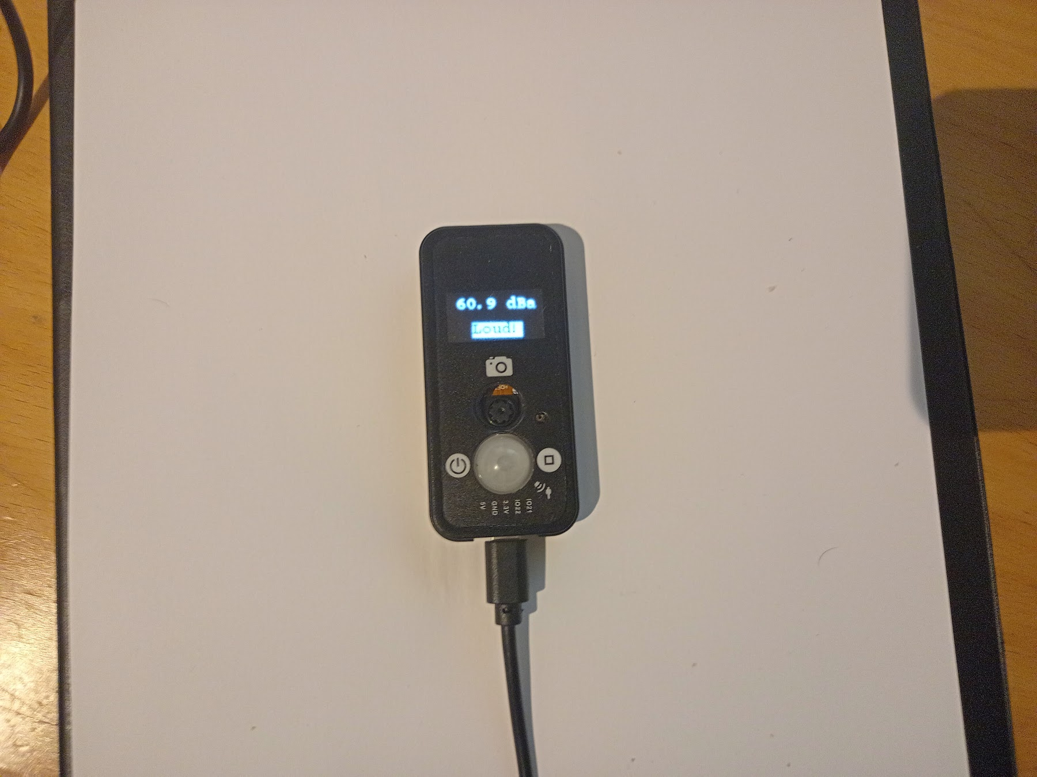
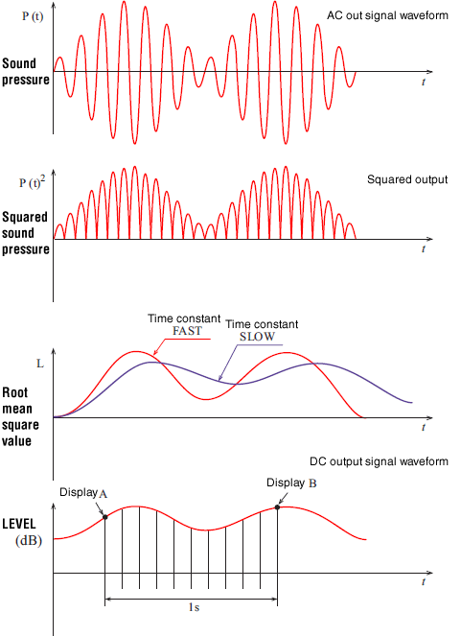
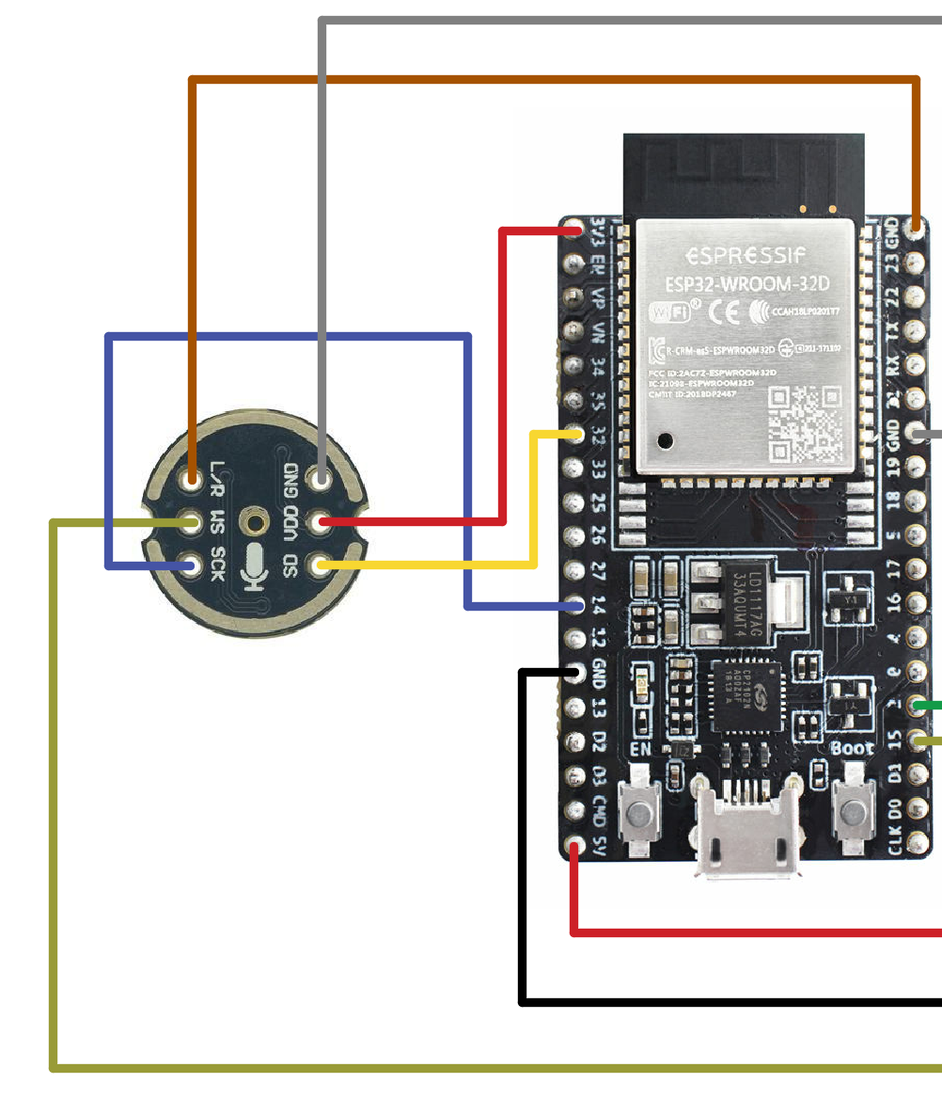
Sound sensor
Soundlevel calculation Processing steps
I2S digital microphone (Example wiring)
Complete hardware unit LilyGo TTGO T-Camera S3

Slide 15
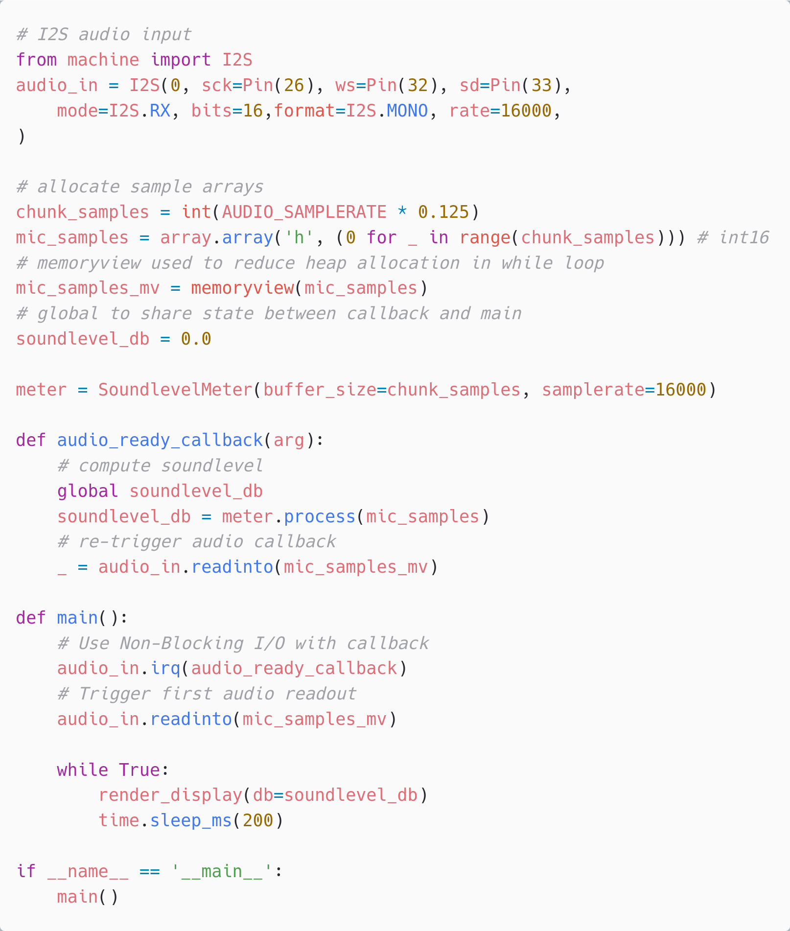
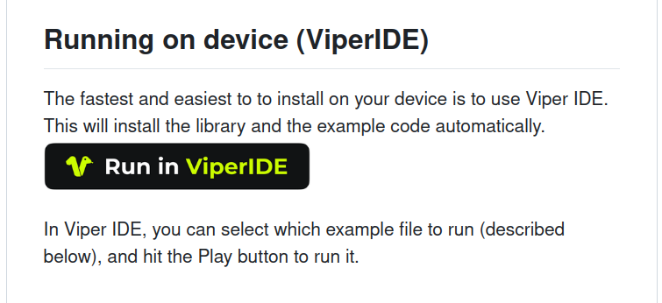
Sound sensor - Install it
Microphone input machine.I2S
https://github.com/emlearn/emlearn-micropython/ tree/master/examples/soundlevel_iir
Rendering text/widgets to screen
https://github.com/peterhinch/ micropython-nano-gui

Slide 16
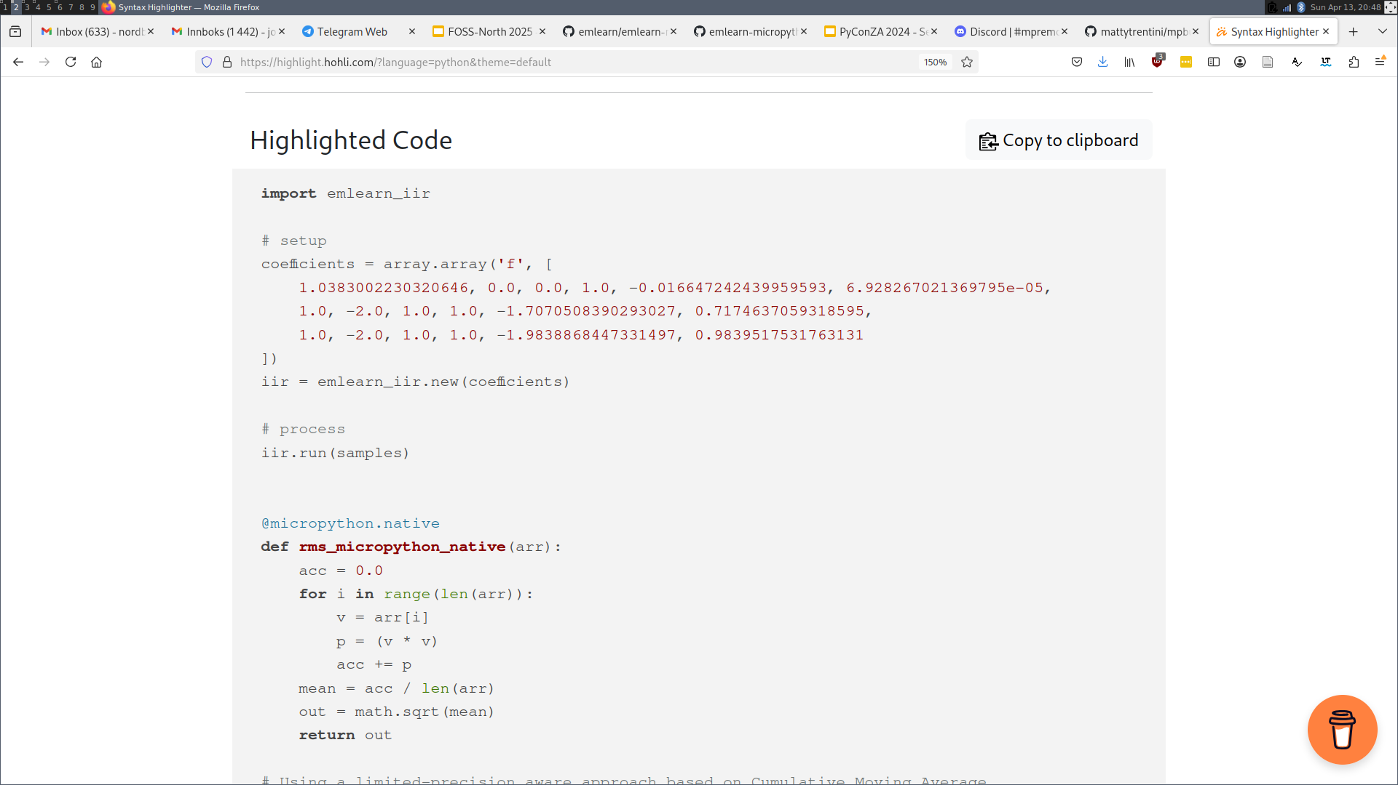
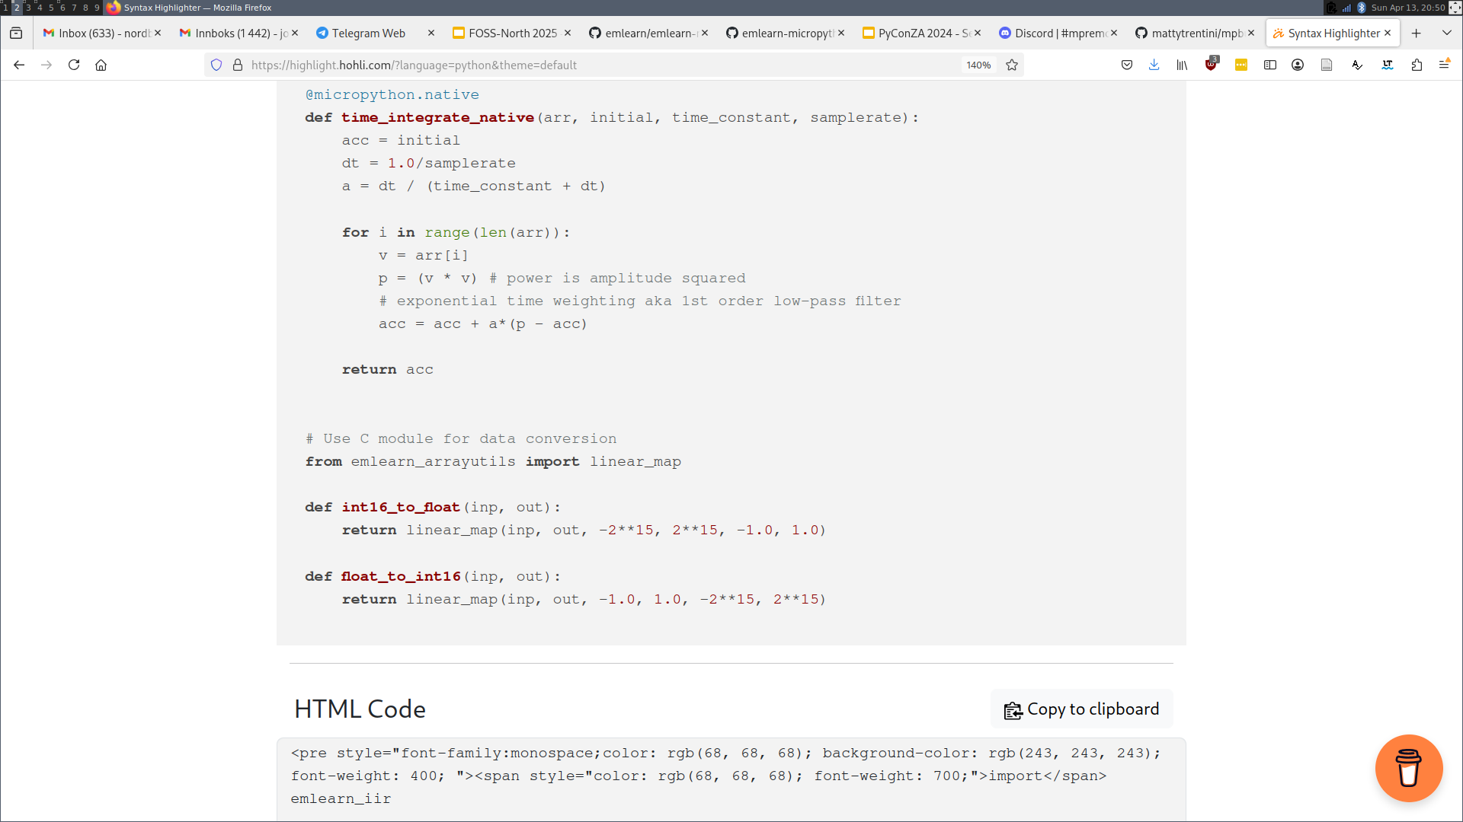
Audio filters using emlearn_iir
Standard sound level measurements are A-weighted. To approximate human hearing.
Implemented using Infinite Impulse Response (IIR) filters.
Must be computed within 125 ms
Python implementation
1100 ms 900% CPU
emlearn_iir C module 30 ms 20% CPU

Slide 17
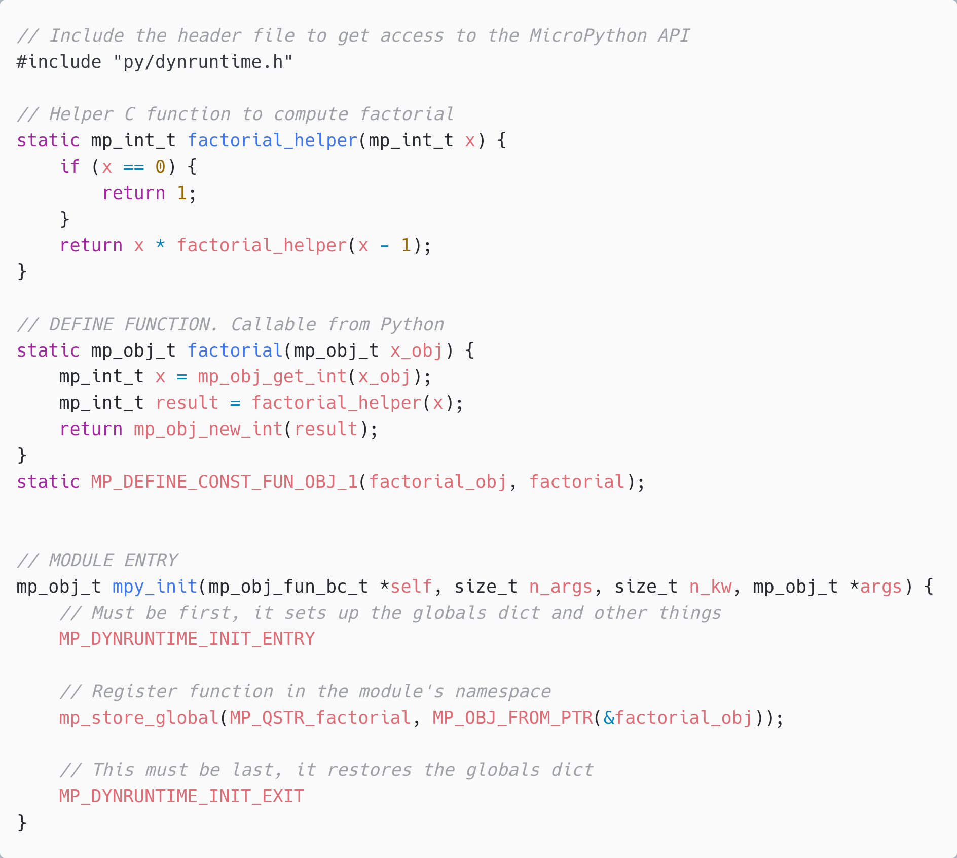
C modules
Written in C. Defines a Python module with API. functions/classes et.c.
Can be implemented by users, libraries or be part of MicroPython core.
Can be portable or specific to one hardware/platform

Slide 18
Native module (.mpy) VS External C module
 | Native module | External C module
Installable at runtime | Yes, as .mpy file | No. Must be included in firmware image
Requires SDK/toolchain | No (only to build) | Yes
Code executes from | RAM | FLASH
Limitations | No libc / libm linked * No static BSS * | None
Maturity | Low * | Excellent
Documentation | https://docs.micropython.org/ en/latest/develop/natmod.html | https://docs.micropython.org/ en/latest/develop/cmodules.html
* Improved greatly in upcoming MicroPython (1.25+). Contributions by Volodymyr Shymanskyy, Alessandro Gatti, Damien George, and others

Slide 19
Activity tracker

Slide 20
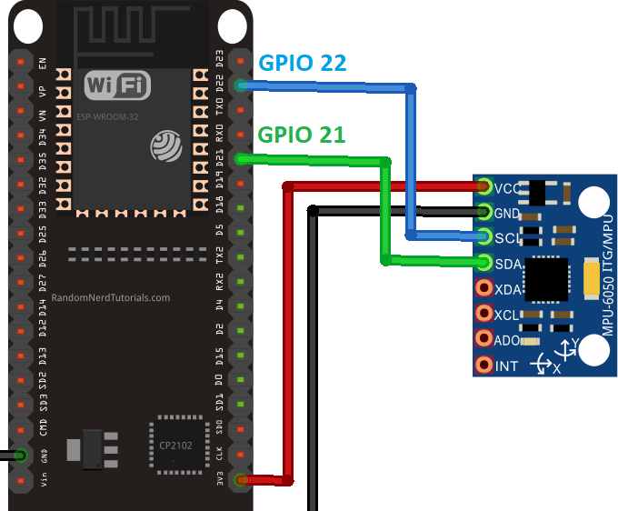
Activity tracker - concept
I2C MEMS IMU accelerometer/gyro (Example wiring)
Complete hardware unit LilyGo T-Watch S3

Slide 21
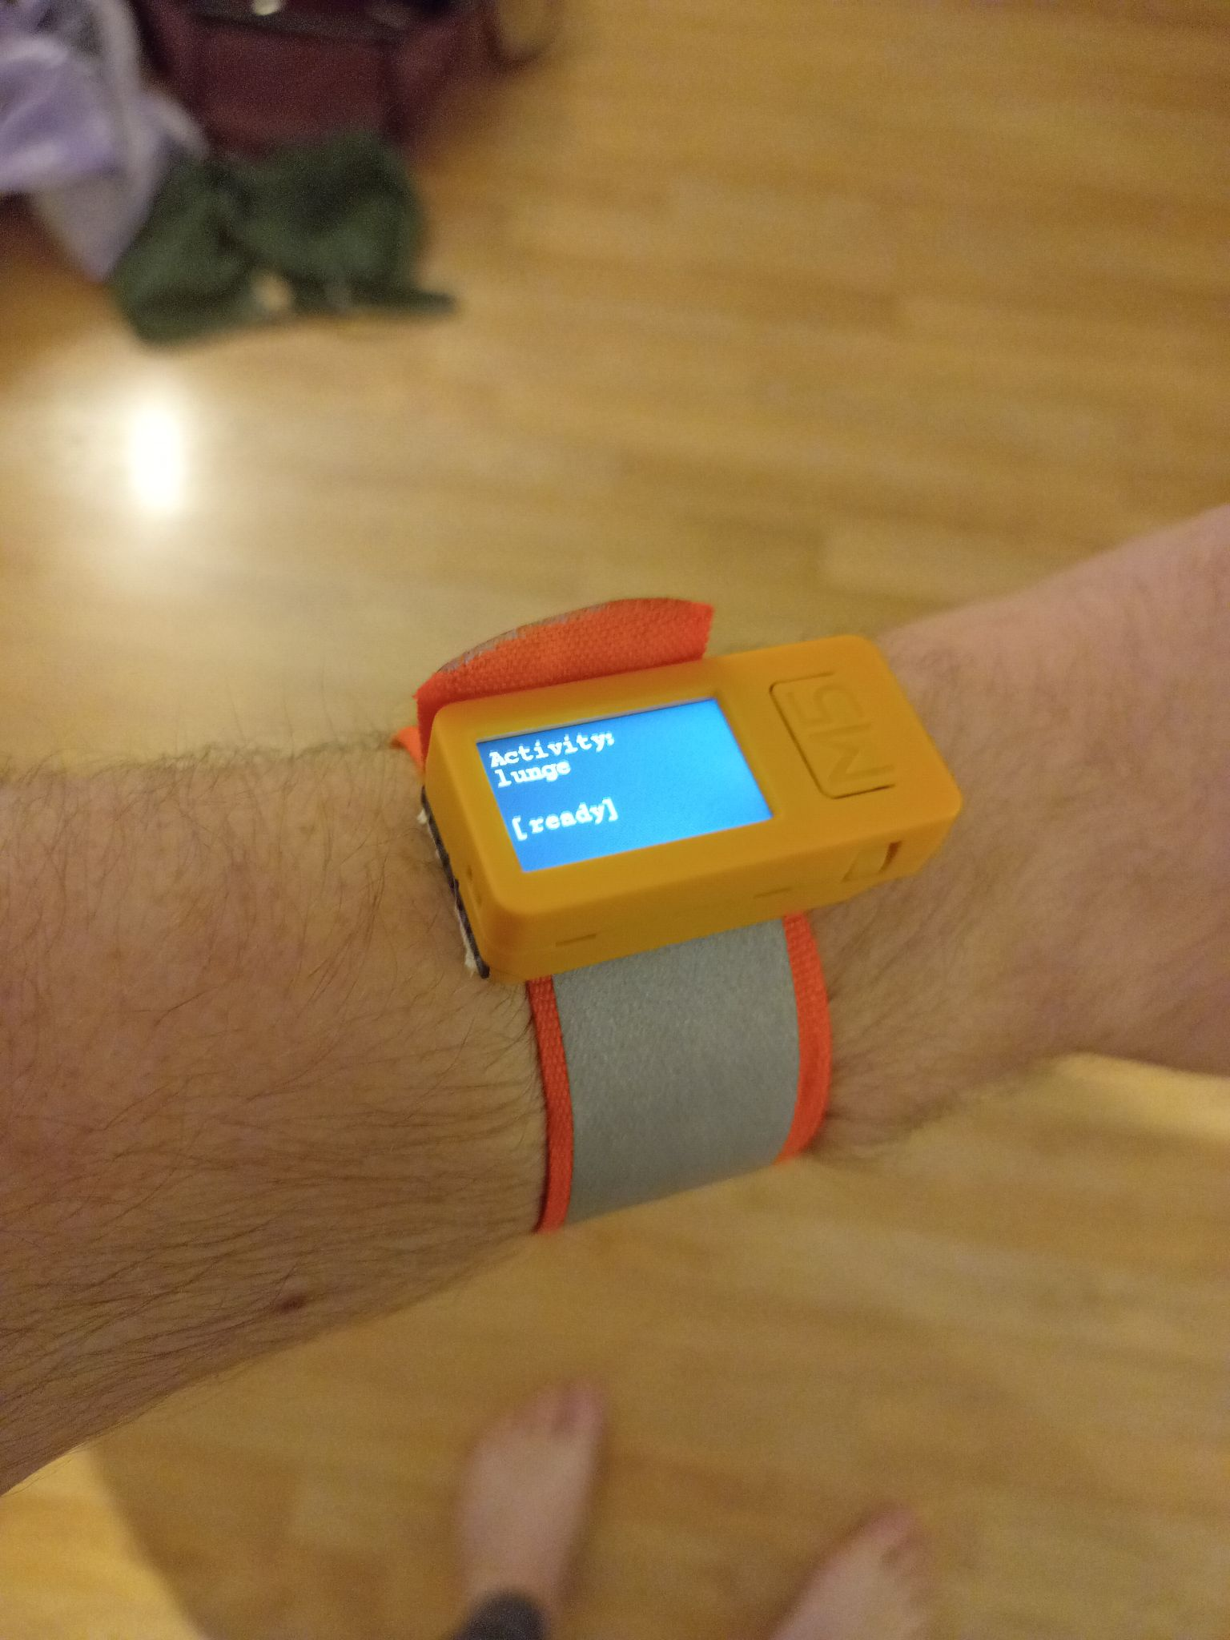
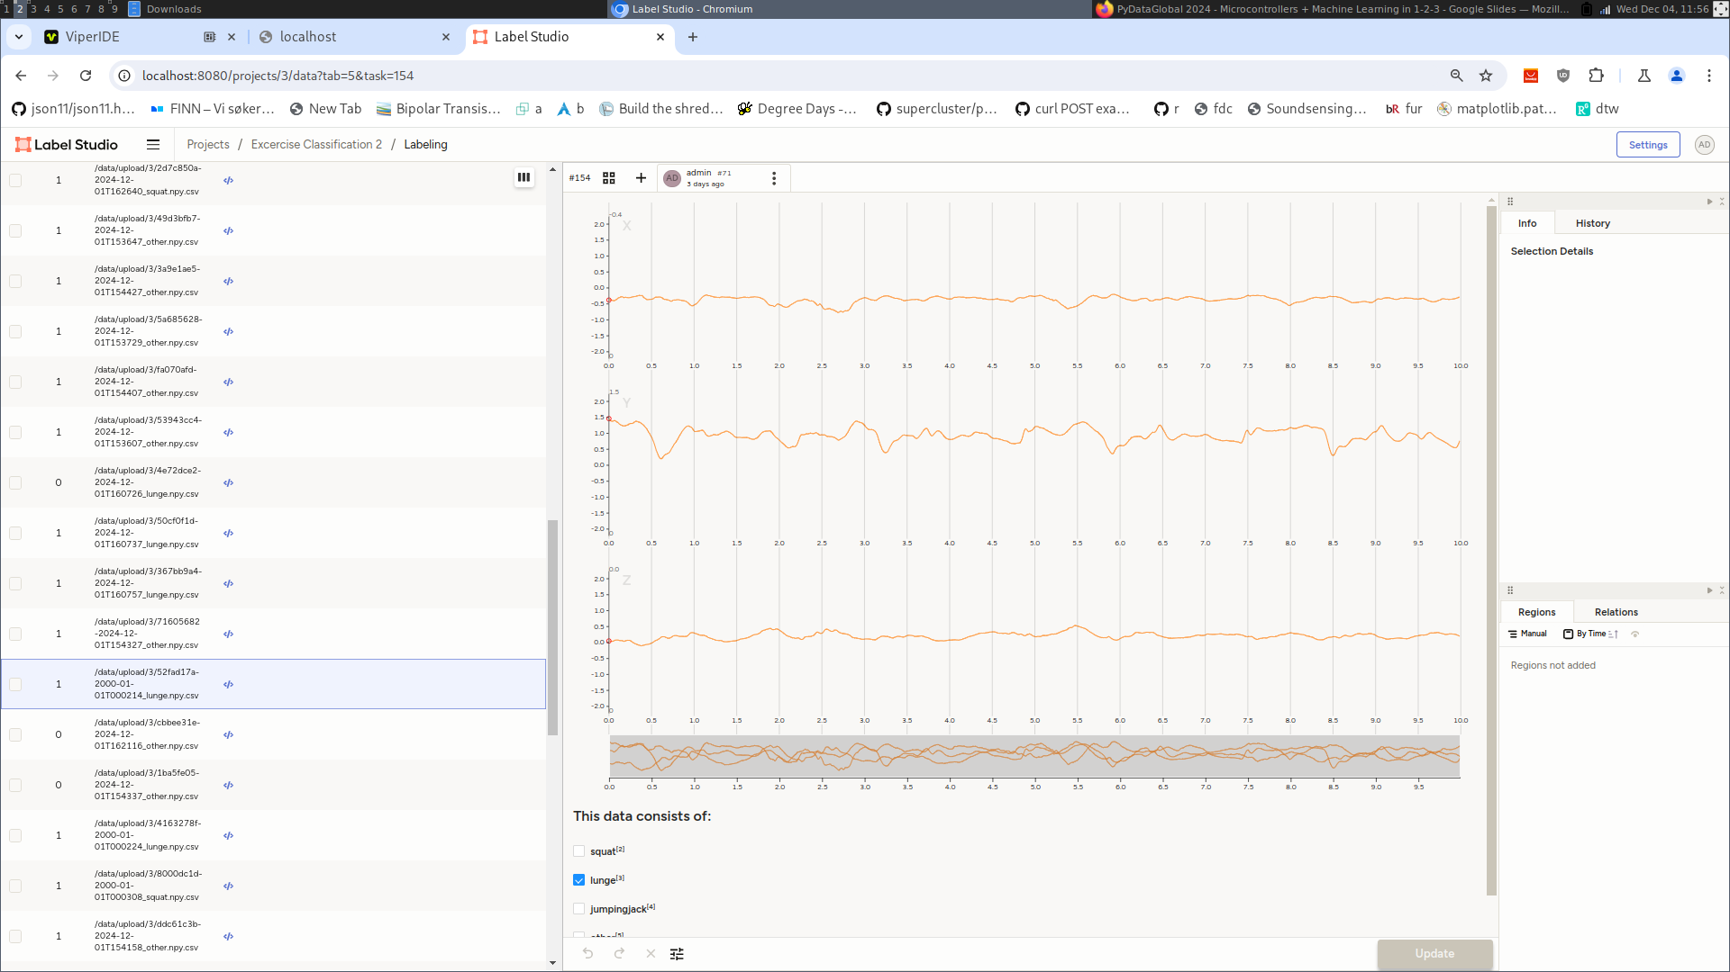
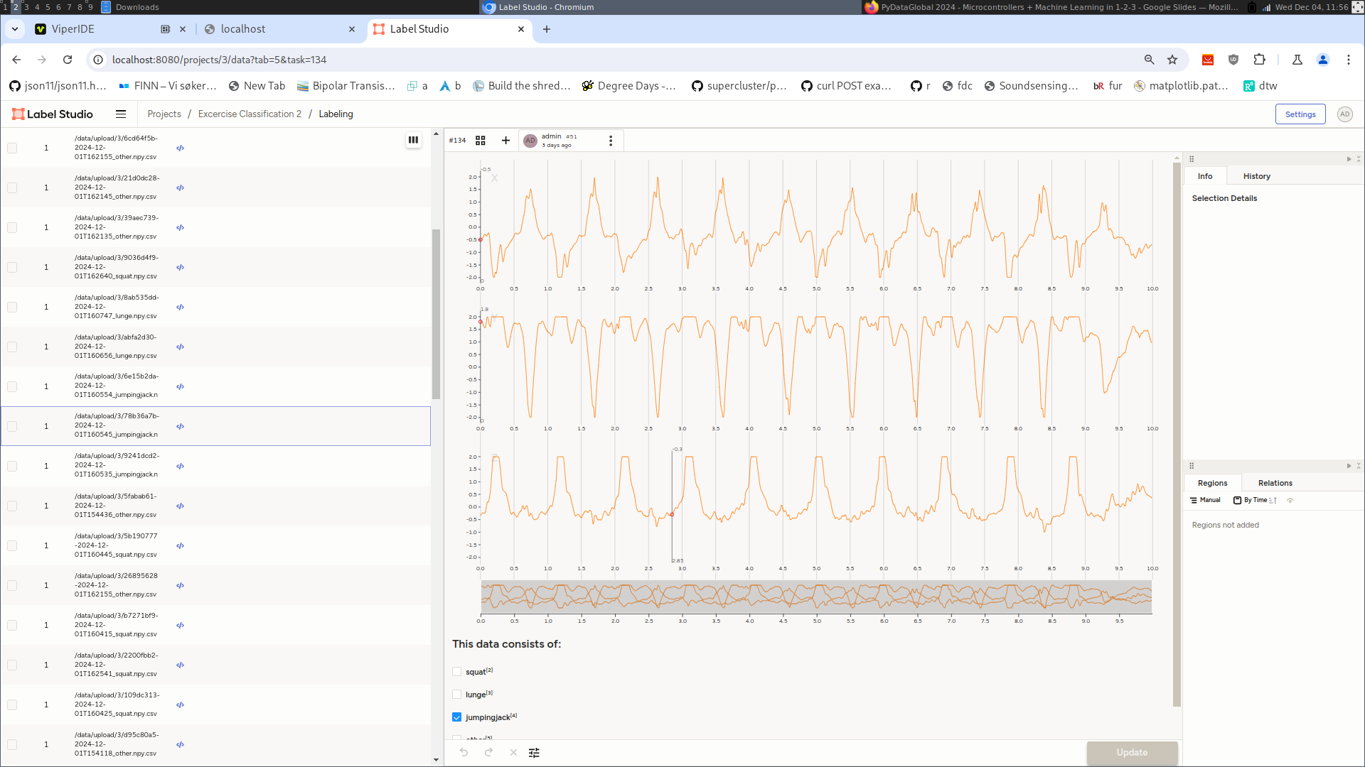

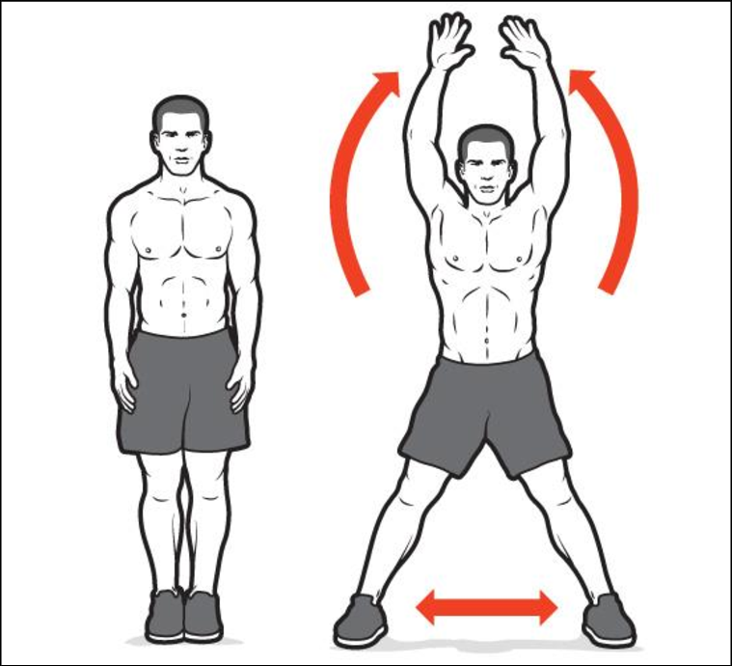
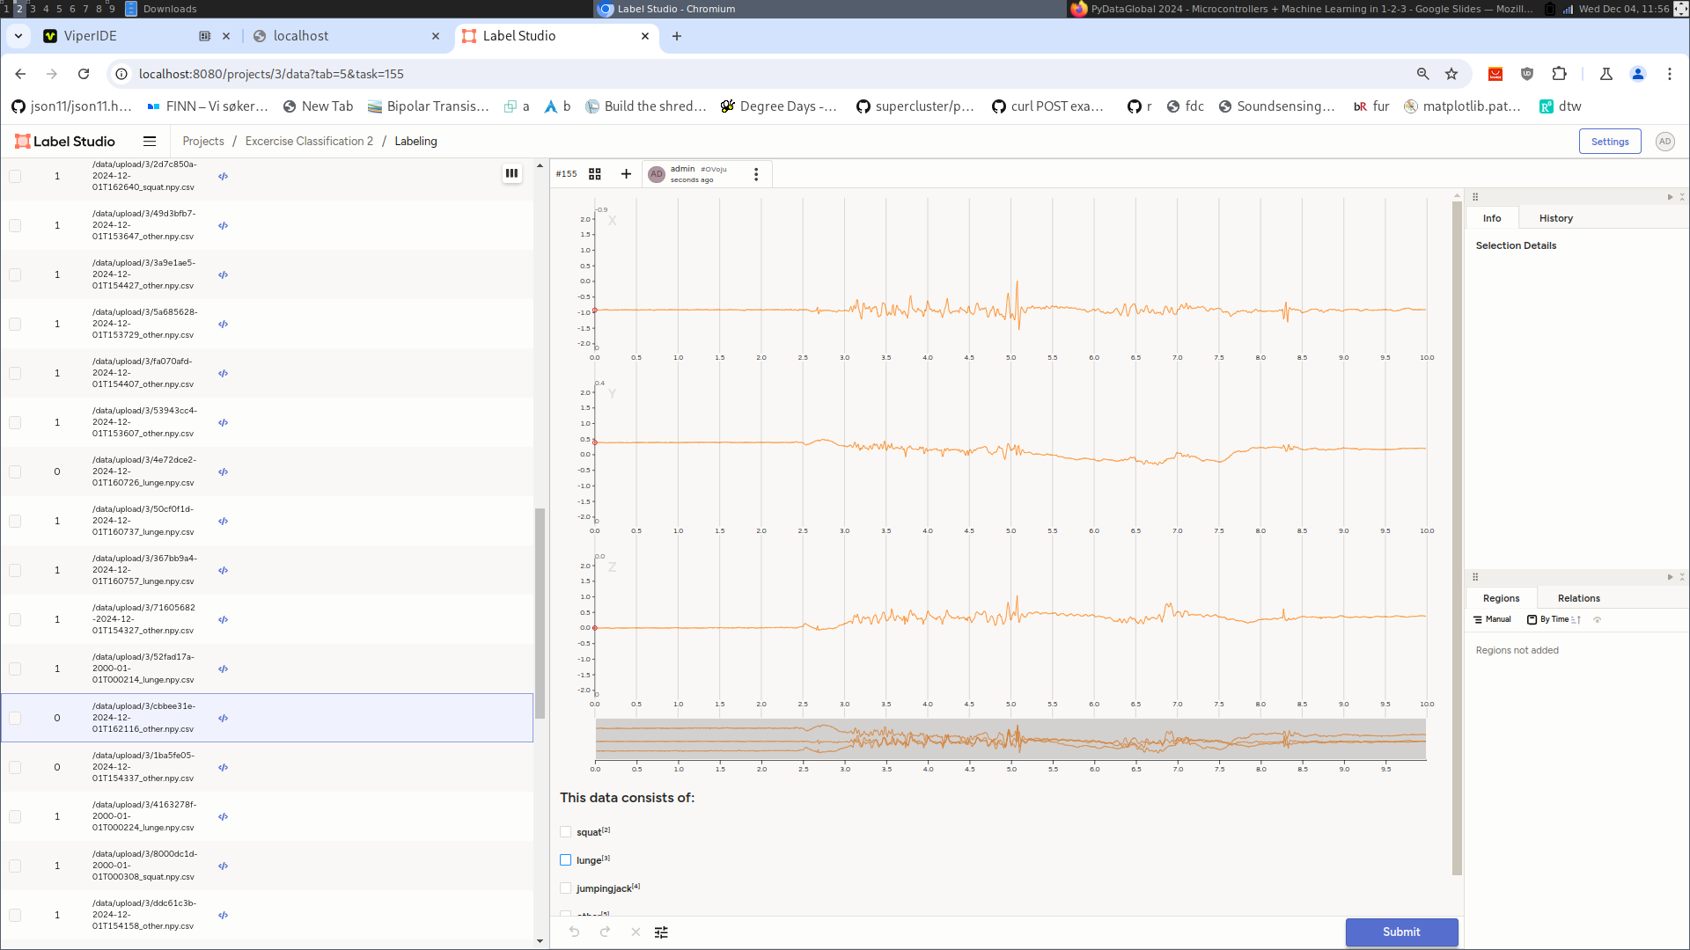
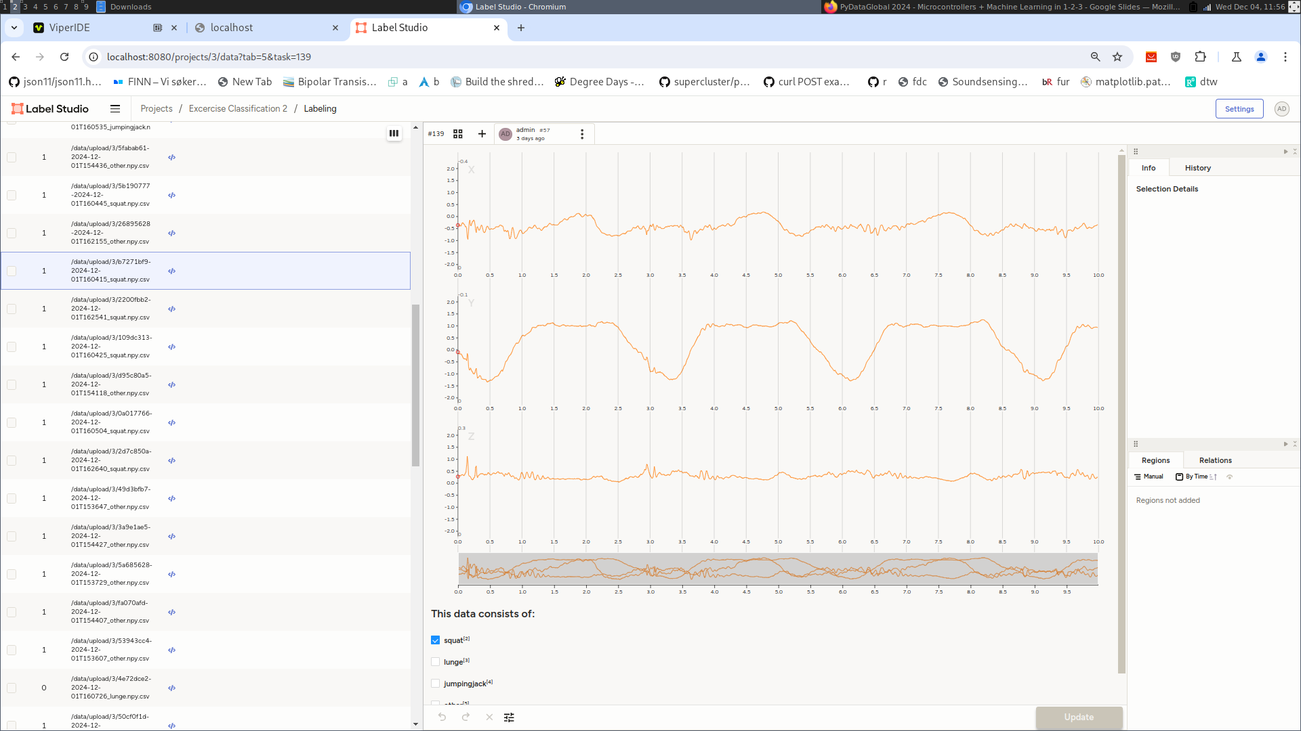

Recording a dataset
har_record.py https://github.com/emlearn/emlearn-micropython/tree/master/examples/har_trees
Jumping Jacks
3 separate series, 1 minute per activity
Saves 10 sec .npy files Transfer over USB
Cleaned labels in Label Studio
“Other”

Slide 22
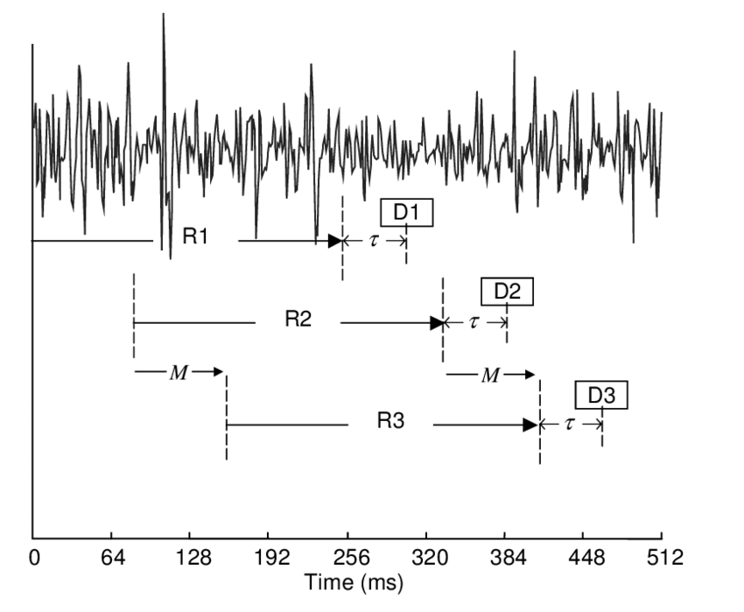
ML on streams: Continuous classification
The sensor data stream is sliced into overlapping windows.
Each window processed independently Exercise activity detection: - 4 second window, every 1 second
- 100 Hz samplerate - Processing time 200 ms
Preprocess
Model
Raw sensor data
Features
Class
[ 42, 4002, … , 329 ]
“Jumping Jacks”
Implementing an IMU/accelerometer/gyro driver? Use the FIFO!
https://github.com/orgs/micropython/discussions/15512
Notes:
The sensor data steam is conceptually infinite
The Machine Learning models on the other hand must have finite and fixed-length inputs
This is done by splitting the stream at fixed intervals of time. Into windows
Usually with some overlap. So model gets multiple chances at predicting the same phenomena

Slide 23
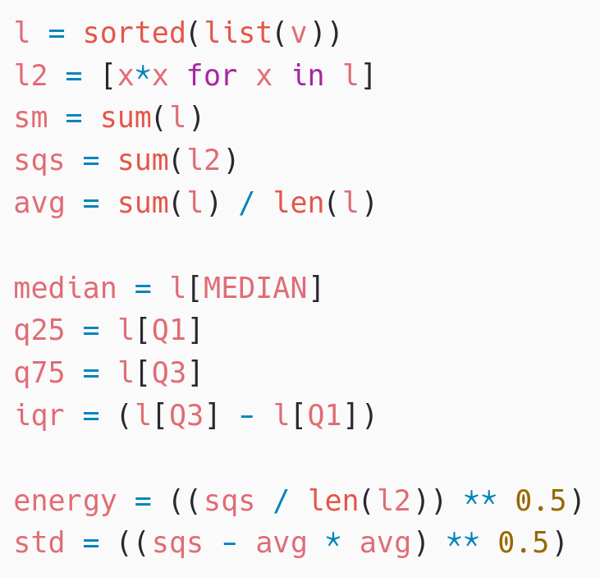
Activity Tracker - Feature Extraction
Statistical summarizations are useful time-series features, sufficient for basic Human Activity Recognition.
! Preprocessing must be compatible between training on host PC (CPython) and device (MicroPython)
Solution: Write preprocessor for MicroPython, re-use in Python
subprocess(‘micropython preprocess.py data.npy features.npy’)
Alternative: (when using common MicroPython/CPython subset)
import mypreprocessor.py
Using micropython-npyfile to read/write Numpy .npy files https://github.com/jonnor/micropython-npyfile/
https://github.com/emlearn/emlearn-micropython/blob/master/examples/har_trees/timebased.py
Time-based features extraction Are Microcontrollers Ready for Deep Learning-Based Human Activity Recognition?
Atis Elsts, and Ryan McConville
https://www.mdpi.com/2079-9292/10/21/2640

Slide 24
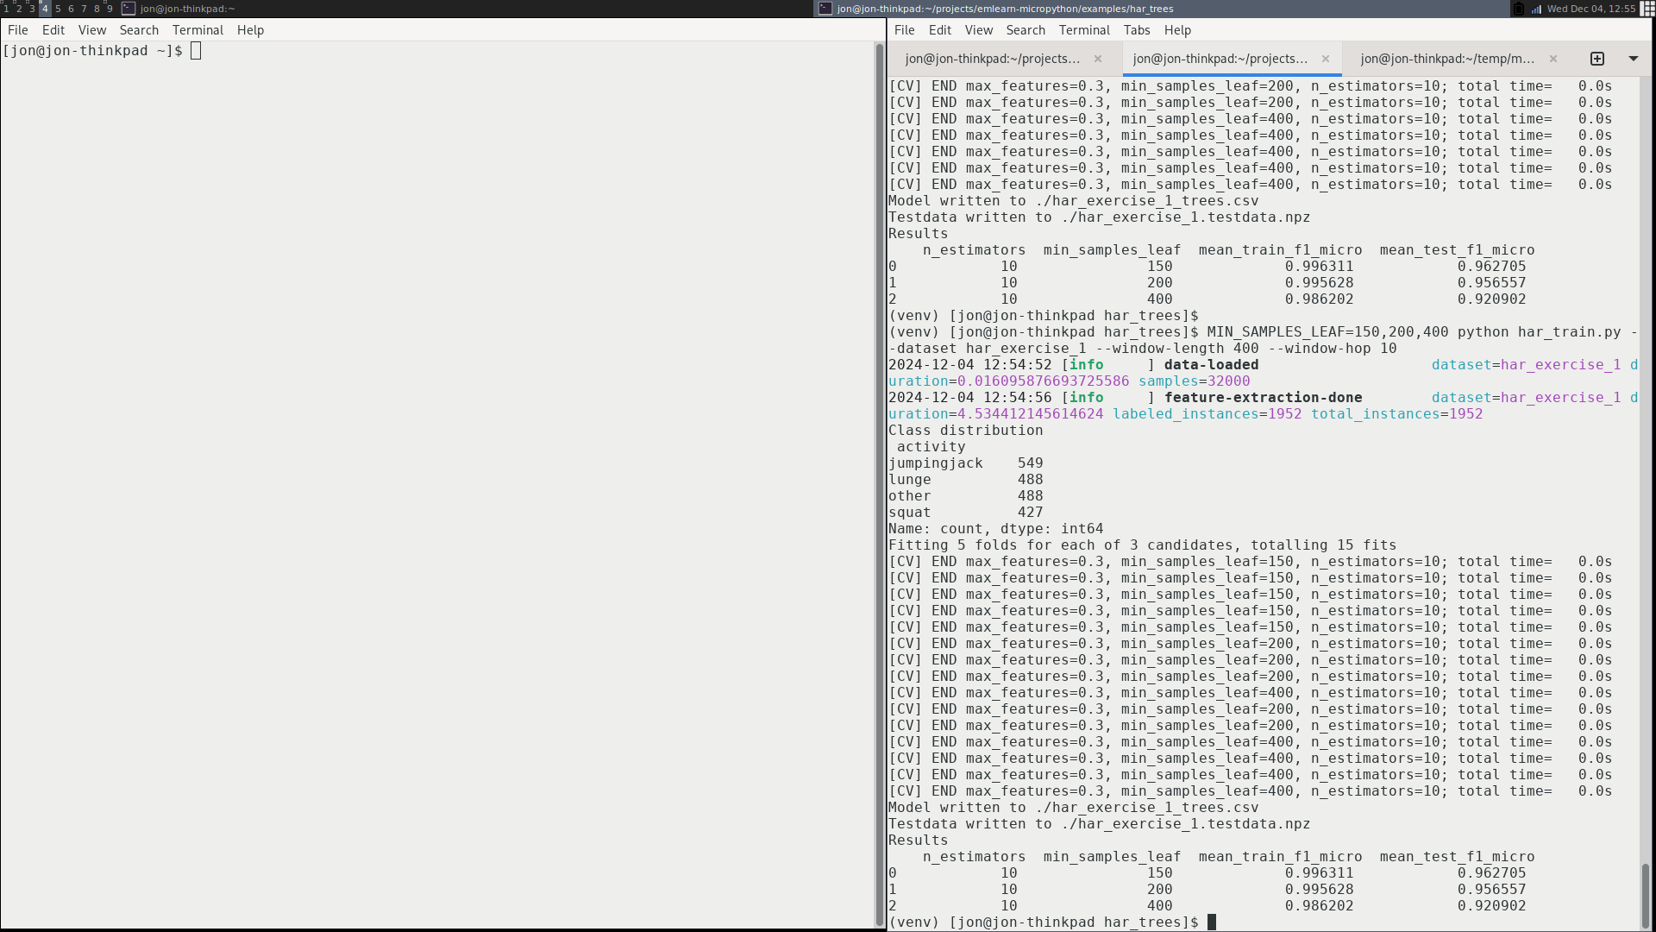
Training model on dataset
Using a scikit-learn based pipeline.
# Setup subject-based cross validation
splitter = GroupShuffleSplit(n_splits=n_splits, test_size=0.25,
random_state=random_state)
# Random Forest classifier
clf = RandomForestClassifier(random_state = random_state,
n_jobs=1, class_weight = "balanced")
# Hyper-parameter search
search = GridSearchCV(clf, param_grid=hyperparameters,
scoring=metric, refit=metric, cv=splitter)
search.fit(X, Y, groups=groups)
har_train.py
import emlearn
converted = emlearn.convert(clf)
converted.save(name='gesture', format=’csv’, file='model.csv')

Slide 25
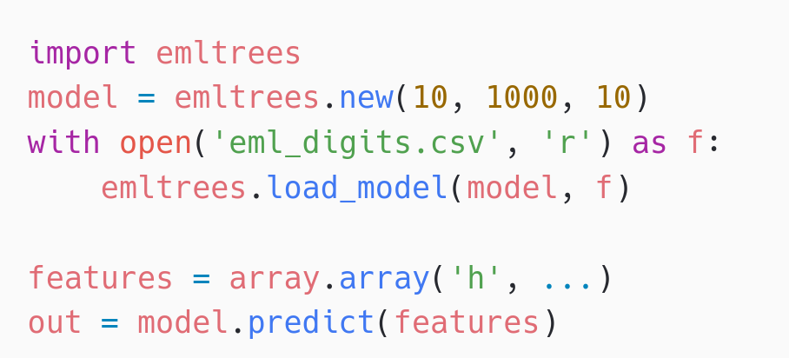
Deploying trained model
Copy model to device
mpremote fs cp gesture_model.csv :
Load and run on device
Performance comparison
10 trees, max 100 leaf nodes, “digits” dataset
Inference time Program space
m2cgen 60.1 ms 179 kB everywhereml 17.7 ms 154 kB
emlearn 1.3 ms 15 kB
emlearn is 10x faster and 10x more space efficient compared to generating Python code

Slide 26
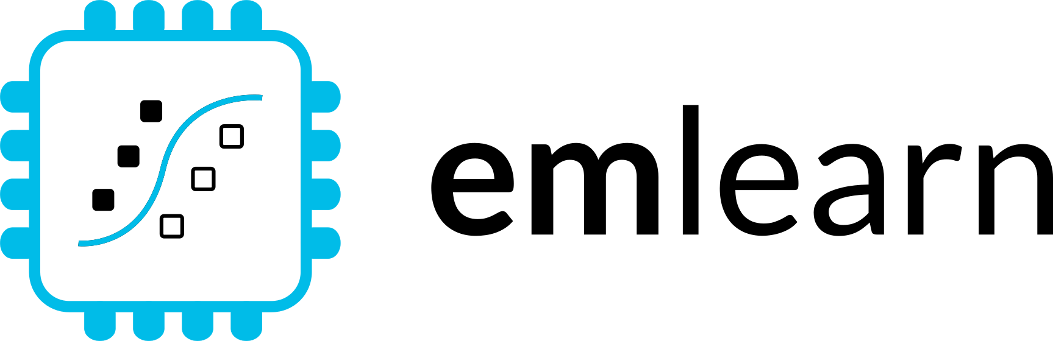





emlearn for C
Embedded Friendly
Portable C99 code
No dynamic allocations
Header-only
High test coverage
Integer/fixed-point math *
Small. 2 kB+ FLASH

Slide 27
Train and export a model
Train using standard Python ML libraries.
from keras import …
model = Sequential([
Dense(16, input_dim=n_features, activation='relu'),
Dense(8, activation='relu'),
Dense(1, activation='sigmoid'),
])
model.compile(....)
model.fit(X_train, Y_train, epochs=1, batch_size=10)
keras neural network
from sklearn.neural_network import MLPClassifier
model = MLPClassifier(hidden_layer_sizes=(100,50,25))
model.fit(X_train, Y_train)
B) scikit-learn neural network
#include <eml_net.h>
static const float mynet_layer_0_biases[8] = { -0.015587f, -0.005395f, -0.010957f, 0.015883f ….
static const float mynet_layer_0_weights[24] = { -0.256981f, 0.041887f, 0.063659f, 0.011013f, …
static const float mynet_layer_1_biases[4] = { 0.001242f, 0.010440f, -0.005309f, -0.006540f };
static const float mynet_layer_1_weights[32] = { -0.577215f, -0.674633f, -0.376140f, 0.646900f, …
static float mynet_buf1[8];
static float mynet_buf2[8];
static const EmlNetLayer mynet_layers[2] = {
{ 8, 3, mynet_layer_0_weights, mynet_layer_0_biases, EmlNetActivationRelu },
{ 4, 8, mynet_layer_1_weights, mynet_layer_1_biases, EmlNetActivationSoftmax }
};
static EmlNet mynet = { 2, mynet_layers, mynet_buf1, mynet_buf2, 8 };
int32_t
mynet_predict(const float *features, int32_t n_features)
{
return eml_net_predict(&mynet, features, n_features);
}
………
2. Use emlearn.convert() and .save()
import emlearn
cmodel = emlearn.convert(model, method='inline')
cmodel.save(file=mynet_model.h', name='mynet')
Example of generated code
Notes:
Training a model is done using a standard framework like scikit-learn or keras.
You will need to already have a dataset collected and labeled for your task.
There is nothing emlearn specific at this point
- although you should use a model small enough to fit on your target device.
We also provide some tools for checking this.
Once you have a trained model, you are ready to deploy it to the device.

Slide 28
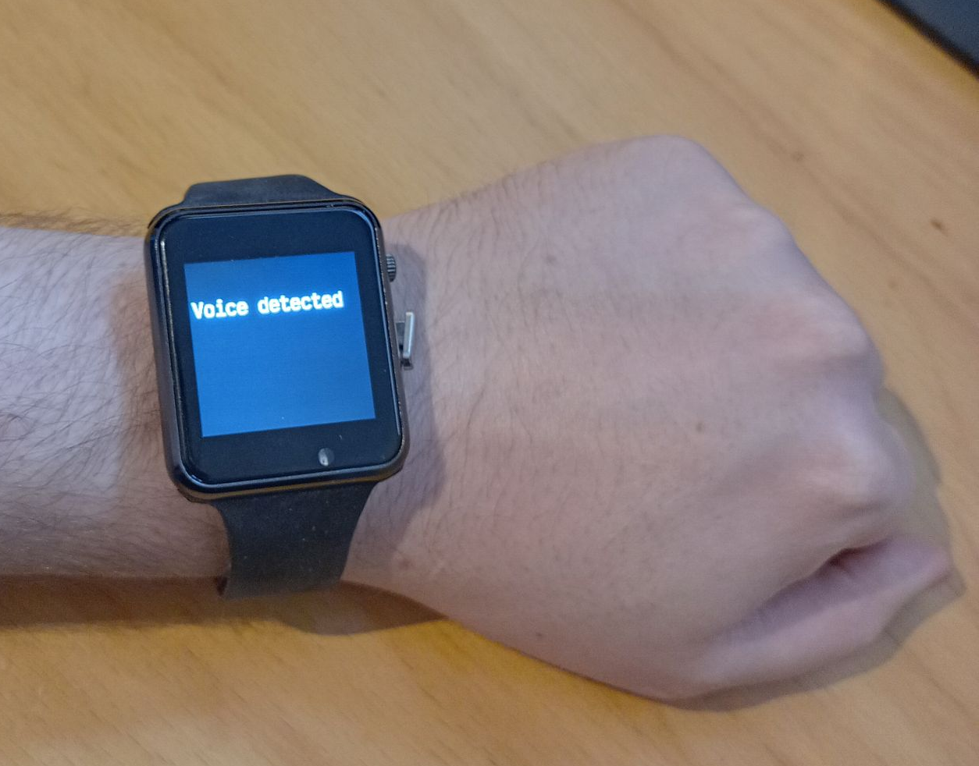
Using the C code
3. #include and call predict()
// Include the generated model code
#include "mynet_model.h"
// index for the class we are detecting
#define MYNET_VOICE 1
// Buffers for input data
#define N_FEATURES 6
float features[N_FEATURES];
#define DATA_LENGTH 128
int16_t sensor_data[DATA_LENGTH];
// Get data and pre-process it
read_microphone(sensor_data, DATA_LENGTH);
preprocess_data(sensor_data, features);
// Run the model
out = mynet_predict(features, N_FEATURES);
// Do something with results
if (out == MYNET_VOICE) {
set_display("voice detected");
} else {
set_display("");
}
setup
loop
Notes:
To use the code, include the generated header file.
Pass the data to the predict() call of the model.
The output can the be used to trigger relevant actions,
such as controlling motors, logging event that occur,
or sent an external system.
In this example, we just show the model output on a display.

Slide 29
Summary

Slide 30
Conclusions
1. Modern microcontrollers are very accessible Runs (Micro)Python! ESP32 recommended ViperIDE easy start
2. MicroPython productive environment for sensor devices Python familiarity and ease-of-use mip package manager Good connectivity
3. Can implement advanced processing of sensor data Accelerometer, audio, image, radar, …. C modules a killer feature emlearn-micropython: modules for DSP and Machine Learning

Slide 31
More resources
emlearn-micropython
emlearn_iir Infinite Impulse Response filters emlearn_trees Random Forest emlearn_fft Fast Fourier Transform emlearn_cnn Convolutional Neural Networks Image classification+ emlearn_neighbors K-nearest Neighbors On-device learning
Ulab: Numpy implementation for MicroPython https://github.com/v923z/micropython-ulab
OpenMV: Computer/Machine Vision for MicroPython https://openmv.io/
PyCon Berlin 2024: Machine Learning on microcontrollers using MicroPython and emlearn https://www.youtube.com/watch?v=S3GjLr0ZIE0 PyData ZA 2024: Sensor data processing on microcontrollers with MicroPython https://za.pycon.org/talks/31-sensor-data-processing-on-microcontrollers-with-micropython/
Notes:
Microcontroller is a small programmable chip.
That since the last 20 years provides the “brain” of basically any electronics device around us.
All the devices that you have in your home have 1 or more microcontrollers each.
A modern car has over 50 microcontrollers.
While they are mostly used for industrial application, they are increasingly accessible for hobbyists and semi-professionals. And today many of these devices can run Python! So in a way, you probably already know how to program them.

Slide 32
Microcontrollers and Machine Learning
with MicroPython and emlearn https://github.com/emlearn/emlearn-micropython
Jon Nordby jononor@gmail.com
foss-north 2025
Notes:
Hi everyone. Glad to see so many being curious about microcontrollers! I have with be a munch of MicroPython compatible devices today. So if anyone is interested in borrowing for trying it out, we can do that after the session. On the A floor, next to the tutorial rooms. And one lucky person that asks a question will get one of these devices to take home!

Slide 33
Bonus

Slide 34
Model optimization
https://emlearn.readthedocs.io/en/latest/model_optimization.html
https://emlearn.readthedocs.io/en/latest/tree_based_models.html

Slide 35
Compute constraints
RAM
64 kB
Reserved
FLASH
512 kB
Reserved
ML pipeline
Post-processing
Post-processing
Memory (RAM)
Program space (FLASH)
Inference time (CPU)
Energy (battery)
Model
Model
Pre-processing
Pre-processing
Sensor reading
Sensor reading
System/ Application
User interface
Drivers
Drivers
CPU
Cortex M4F
User interface
Connectivity
Connectivity
Active time
Send
Send
Sleep zzzzZZZ
Energy
Total time
Time
Notes:
Inline and loadable (data structure) Majority voting instead of class probabilities Leaf-node de-duplication

Slide 36
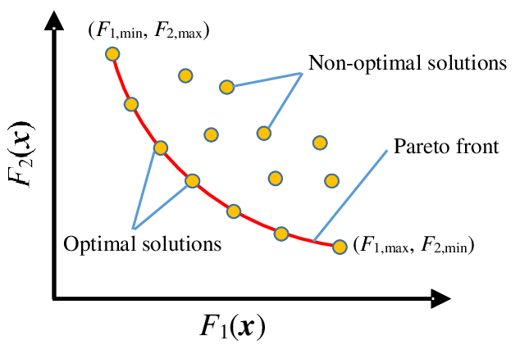
Pareto front - performance/compute tradeoffs
Many possible combinations of predictive performance vs computational cost
No point considering the non-optimal solutions!
Pareto front is formed by the set of optimal solutions - that dominate the non-optimal ones
Describes the possible tradeoffs between predictive performance and compute
Utilities for finding Pareto front in emlearn.evaluate.pareto https://emlearn.readthedocs.io/en/latest/evaluate.html Example: https://emlearn.readthedocs.io/en/latest/auto_examples/trees_hyperparameters.html
Notes:
Inline and loadable (data structure) Majority voting instead of class probabilities Leaf-node de-duplication

Slide 37
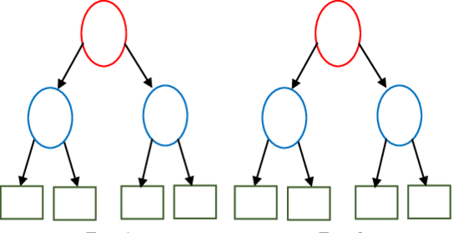
Tree-based ensembles - costs
Input features, length F [ 0.23, 0.56, 0.11, 0.55 ]
IF features[2] < 0.74 THEN next=left ELSE next=right
Depth D
Tree 1
Tree 2
No. features F [0]
No. trees T
Tree Depth D_max [1] / D_eff [2]
No. nodes N ≈ T * (2 ** D)
Computational costs
Memory (RAM) O(F)
Program (FLASH) O(N) [3]
Exc. time (CPU) sum(D_eff(t), t -> T)
[0] May also enable deeper trees
[1] Depth might differ across trees [2] Execution path is data dependent! Can estimate average using a dataset, or worst-case from model [3] Assuming leaf and decision nodes same size
cl1
cl2
Utilities for estimating costs
from emlearn.evaluate.trees import model_size_bytes, compute_cost_estimate
Notes:
Inline and loadable (data structure) Majority voting instead of class probabilities Leaf-node de-duplication

Slide 38
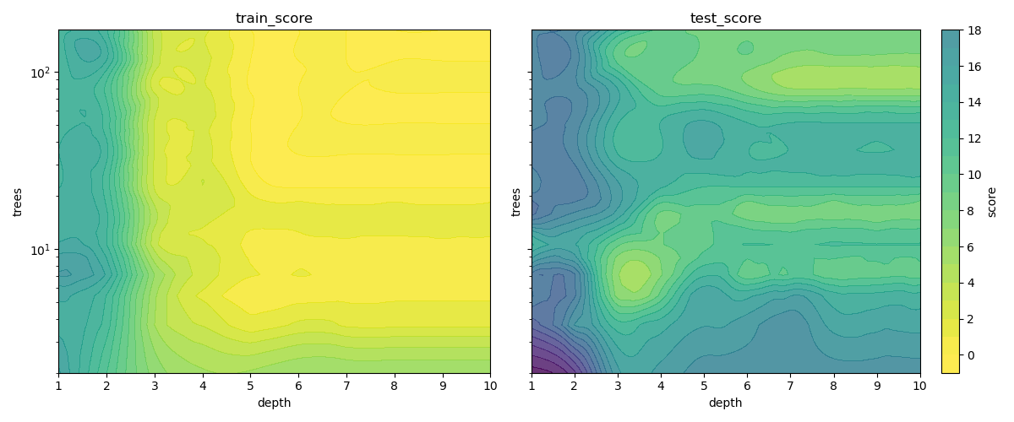
Tree-based ensemble - predictive performance
No. features F increases capacity
No. trees T increases capacity, decreases overfitting
Tree Depth D_max / D_eff increases capacity, increases overfitting
No. nodes N ≈ T * D
For generalized performance (on unseen data), need to balance overfitting.
Notes:
Inline and loadable (data structure) Majority voting instead of class probabilities Leaf-node de-duplication

Slide 39
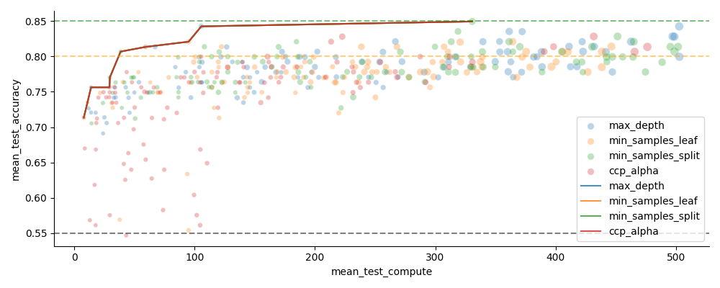
Hyperparameter tuning with scikit-learn
Vary n_estimators (trees) and one of the depth limiting hyperparameters
from sklearn.model_selection import GridSearchCV, RandomizedSearchCV
https://emlearn.readthedocs.io/en/latest/auto_examples/trees_hyperparameters.html
Notes:
Inline and loadable (data structure) Majority voting instead of class probabilities Leaf-node de-duplication

Slide 40
Bonus

Slide 41
TinyML for MicroPython - comparisons
Project | Deployment | Models | Size | Compute time
emlearn -micropython | Easy. Native mod .mpy | DT, RF, KNN, CNN | Good | Good
everywhereml | Easy. Pure Python .py | DT, RF, SVM, KNN, | High with large models | Poor
m2cgen | Easy. Pure Python .py | DT, RF, SVM, KNN, MLP | High with large models | Poor
OpenMV.tf | Hard. Custom Fork | CNN | High initial size | Good
ulab | Hard. User C module | (build-your-own) Using ndarray primitives | High initial size | Unknown (assume good)
Notes:
Benchmark vs other MicroPython approaches

Slide 42
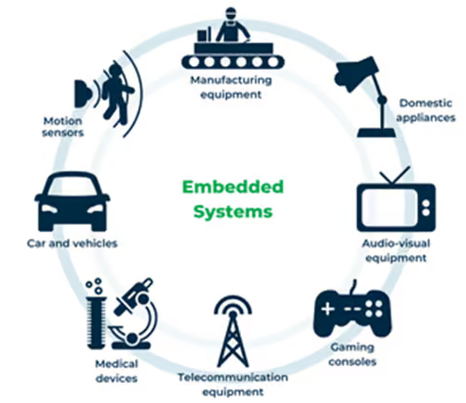
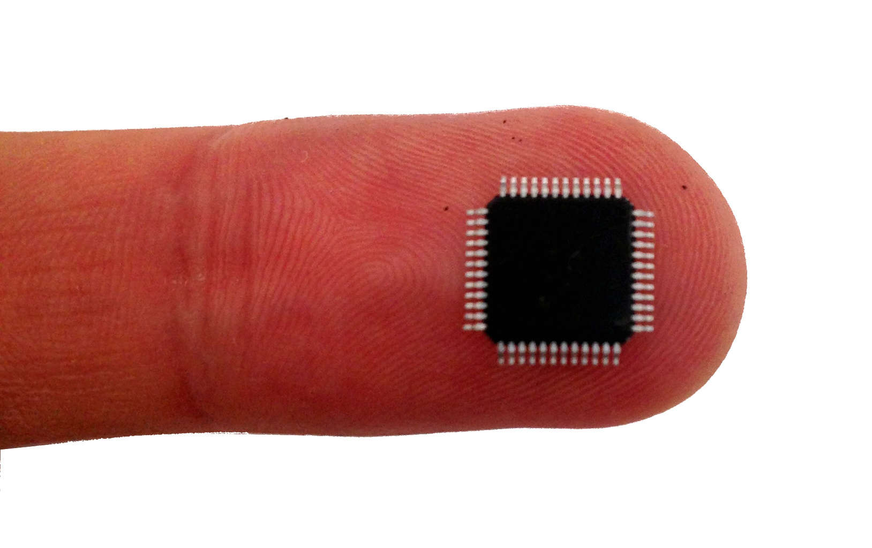
Microcontroller - tiny programmable chip
Compute power: 1 / 1000x of a smartphone
RAM: 0.10 - 1 000 kB
Program space: 1.0 - 10 000 kB
Compute 10 - 1 000 DMIPS
Price: 0.10 - 10 USD
Energy: 1 - 1 000 milliWatt
Efficiency is key ! Memory, compute, power
Over 20 billions shipped per year!
Increasingly accessible for hobbyists
2010: Arduino Uno 2014: MicroPython 2019: MicroPython 1.10 - ESP32 PSRAM
Notes:
Microcontroller is a small programmable chip.
That since the last 20 years provides the “brain” of basically any electronics device around us.
All the devices that you have in your home have 1 or more microcontrollers each.
A modern car has over 50 microcontrollers.
While they are mostly used for industrial application, they are increasingly accessible for hobbyists and semi-professionals. And today many of these devices can run Python! So in a way, you probably already know how to program them.

Slide 43
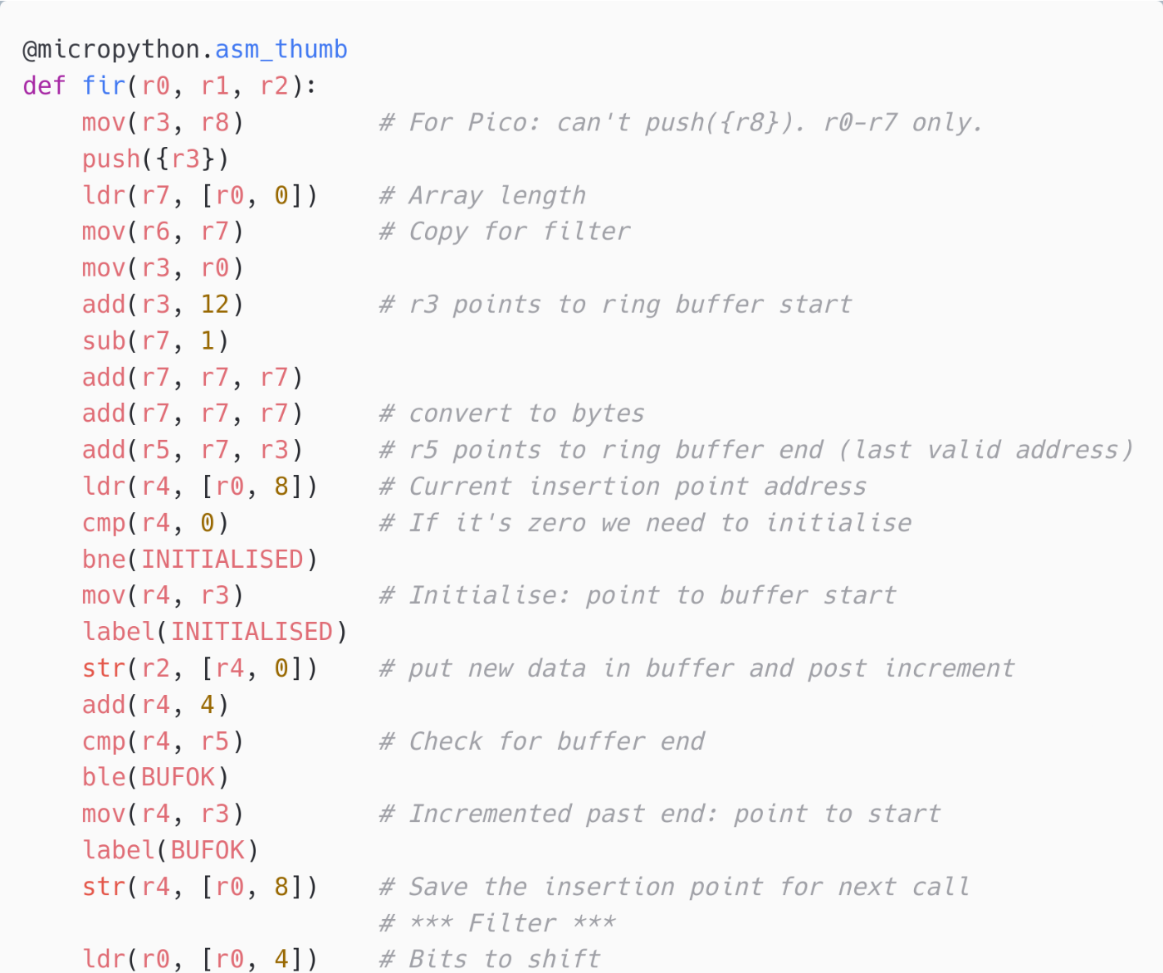
Inline Assembly
MicroPython can expose Assembler opcodes as Python statements.
Allows to write a function in Assembler inline in the Python program Can compile and execute on device
Supported on ARM Cortex M chips Not supported (yet) on ESP32
For the most hardcore hackers!
Official Documentation: https://docs.micropython.org/en/latest/ reference/asm_thumb2_index.html
Example: FIR filter implementation (cut out) https://github.com/peterhinch/micropython-filters/ blob/master/fir.py

Slide 44
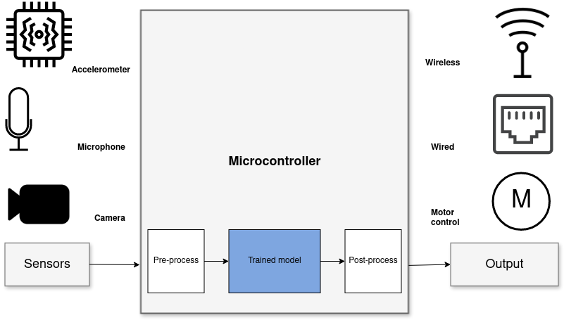
Sensor node systems
Including on-sensor data processing with Digital Signal Processing (DSP) and Machine Learning (ML)
“Internet of Things”
“Wearable devices”
Robotics, Industrial automation
Notes:
But one usecase where ML is incredibly useful is in analysing sensor data.
Sensors such as accelerometers, microphonones, radars, and cameras have gotten incredibly cheap and powerful.
But in order to get useful information out of these, the raw data must be processed.
Using Machine Learning, in combination with Digital Signal Processing, allows analyzing complex phenomena.
If this is done on the microcontroller, we get a range of benefits:
...
The component in blue is the Machine Learning model, and is typically trained ahead of time on a PC.

Slide 45
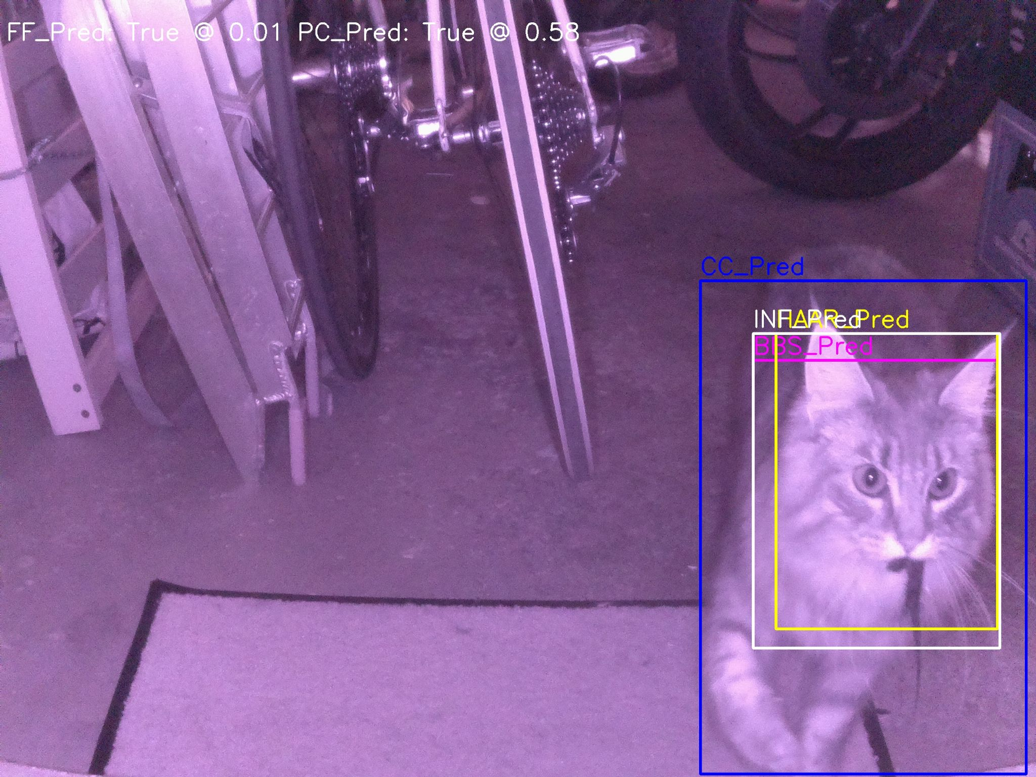
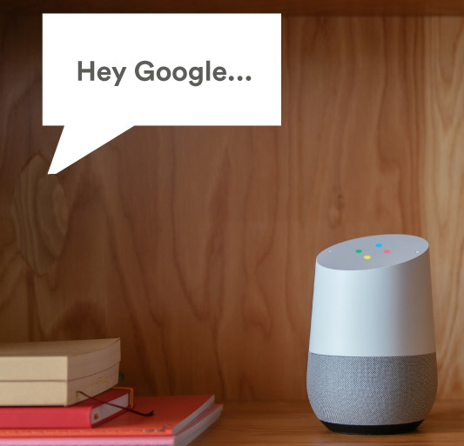




Applications
Consumer Tech
Industrial
Fun
Notes:
This is a huge amount of applications for this, in basically any field that uses electronics.
Keyword spotting / wakeword detection. “Alexa” Smartwatch. Sleep activity tracking Agriculture. Cattle activity tracking Condition monitoring of Machinery.
Or what about a cat doorbell that only lets in your cat, and only if it does not have a prey in its both. Magic wand.

Slide 46

Cat Detector - Data Acquisition
Classify low-res images, at 1 FPS+
Using mp_camera by cnadler86 https://github.com/ cnadler86/micropython-camera-API 96x96 px grayscale.
Takes ~100 ms - OK

Slide 47


Cat Detector - Classification with CNN
emlearn_tinymaix_cnn
Go-to solution for image classification:
Convolutional Neural Network (CNN)
32x32 px input. 3 layers. Under 100 ms - OK
Preprocessing (untested) Downscaling 96 px -> 32 px
Image brightness normalization
See also OpenMV - MicroPython for Computer Vision- https://docs.openmv.io/index.html
https://github.com/emlearn/emlearn-micropython/ tree/master/examples/mnist_cnn

